Slide 1
Connections

Slide 2
Serial data

Slide 3
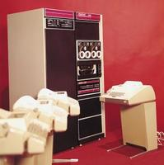
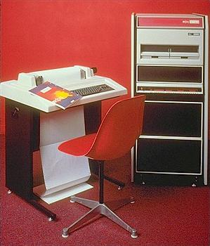
Serial Terminals

Slide 4
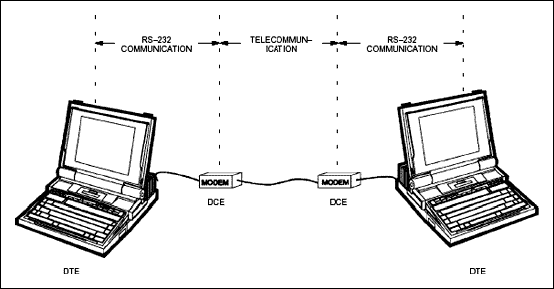
Serial connections
Telecommunication History 101
RS-232
DTE – Data Terminal Equipment
Teletype
Computer
DCE – Data Communications Equipment
Modems
Send
Receive

Slide 5
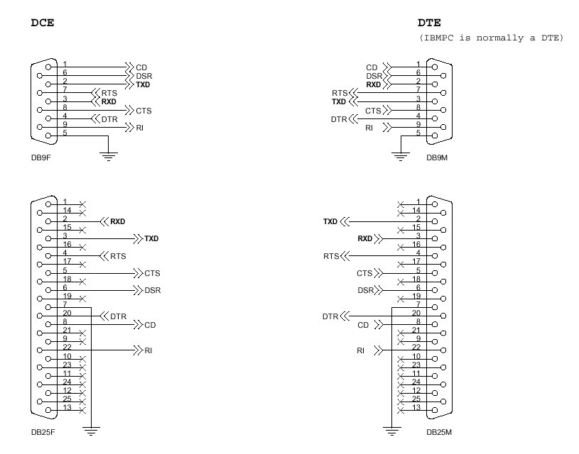

Slide 6
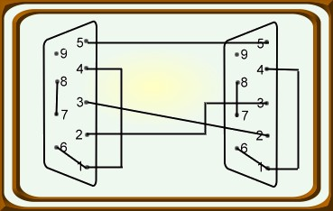
Computer to Computer?
What if equipment close by?
Direct DTE-DTE
Conflict of signals!
Receive to receive
Send to send - !!!!
Solution:
Use a “null” modem

Slide 7
Configuration
Must configure to connect:
Correct Speed
110, 300, 1200, 2400, 4800, 9600, etc.
Number of bits
7 or 8
Parity
None, even, odd, mark, space
Stop bits
1 or 2
Most modern devices default:
9600-8-n-1

Slide 8
Ethernet

Slide 9
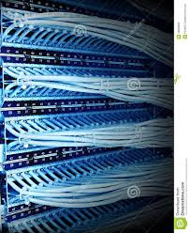
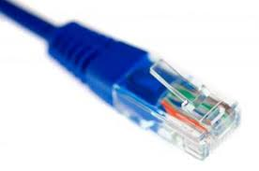
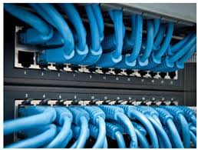
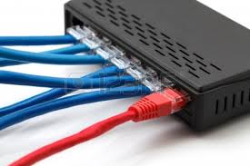
Ethernet

Slide 10
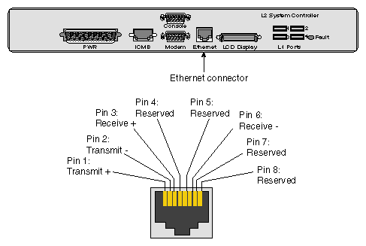
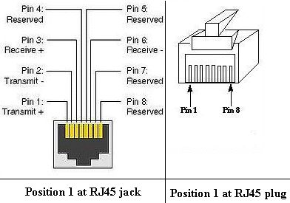
Ethernet
Standard cable and jack
RJ-45 (8 pins)
Send on 1-2
+ P1
- P2
Receive on 3-6
+ P3
- P6

Slide 11
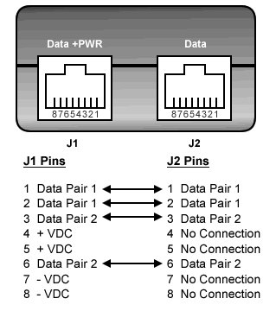
Ethernet + Power
Power over Ethernet
Add power to the spare wires

Slide 12
EIA/TIA 568A and B
568A WIRING STANDARD
568B WIRING STANDARD
PIN | WIRE COLOR
1 | White w/Green Stripe
2 | Green w/White Stripe
3 | White w/Orange Stripe
4 | Blue w/White Stripe
5 | White w/Blue Stripe
6 | Orange w/White Stripe
7 | White w/Brown Stripe
8 | Brown w/White Stripe
PIN | WIRE COLOR
1 | White w/Orange Stripe
2 | Orange w/White Stripe
3 | White w/Green Stripe
4 | Blue w/White Stripe
5 | White w/Blue Stripe
6 | Green w/White Stripe
7 | White w/Brown Stripe
8 | Brown w/White Stripe
Note: Only pairs 2 and 3 are used for Standard Ethernet wiring. Pairs 1 and 4 can be used for other purposes such as telephones or even a second separate, complete Ethernet connection.

Slide 13
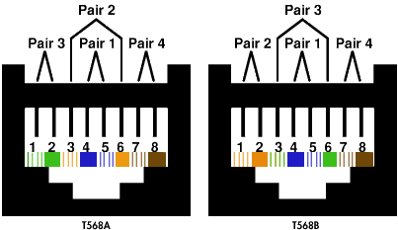
EIA/TIA Cable pairings

Slide 14
Two Ethernets over one cable
Pin No. | conductor color | Name
1 | white and orange | TX_D1+
2 | orange | TX_D1-
3 | white and green | RX_D2+
4 | blue | BI_D3+ **
5 | white and blue | BI_D3- **
6 | green | RX_D2-
7 | white and brown | BI_D4+ **
8 | brown | BI_D4- **
Use pairs 1 and 4 for the second Ethernet connection

Slide 15
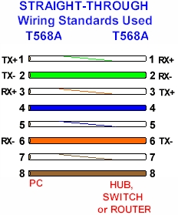
Ethernet Wiring Conventions
Note:
PC (NIC) side “opposite” definitions than the switch or router side
Colors may change

Slide 16
“typical” connection
Networking Device
No problem!
PC
PC

Slide 17
PC to PC?
Big problem!
PC 1 Receive connected to PC2 Receive
Bigger problem!
PC1 Transmit connected to PC2 Transmit!
PC1
PC2

Slide 18
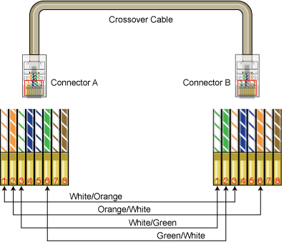
PC to PC Solution
Crossover cable

Slide 19
Auto Sense
Some devices “auto sense” and set up the proper connections

