Slide 1
Backup
http://en.wikipedia.org/wiki/Backup

Slide 2
Backup
Backup refers to making copies of data
Copies may be used to restore the original after a data loss
Copies are typically called "backups"
Backups are useful primarily for two purposes:
Restore a computer to an operational state following a disaster (disaster recovery)
Restore small numbers of files after they have been accidentally (or deliberately) deleted or corrupted
Backups are typically that last line of defense against data loss
Consequently the least granular and the least convenient to use

Slide 3
Backup
Backup system contains at least one copy of all data worth saving
Data storage requirements can be considerable
Organizing this storage space and managing the backup process is can be a complicated undertaking
Data repository model can be used to provide structure to the storage
There are many different types of data storage devices that are useful for making backups
Many different ways in which these devices can be arranged to provide
geographic redundancy
data security
portability

Slide 4
Backup
Before data is sent to its storage location, it must be
Selected
Extracted
Manipulated
Many different techniques have been developed to optimize the backup procedure
Includes optimizations for dealing with
open files
live data sources
compression, encryption, and de-duplication

Slide 5
Backup
Many organizations and individuals try to have confidence that the process is working as expected and work to define measurements and validation techniques
It is also important to recognize the limitations and human factors involved in any backup scheme

Slide 6
Backup
Due to overlaps in technology, backups and backup systems are frequently confused with archives and fault-tolerant systems
Backups differ from archives:
archives are the primary copy of data
Originals no longer actively needed
backups are a secondary copy of data
Originals actively used
Backup systems differ from fault-tolerant systems
backup systems assume that a fault will cause a data loss event
fault-tolerant systems assume a fault will not

Slide 7
Storage
The base of a backup system

Slide 8
Data repository models

Slide 9
Data repository models
Any backup strategy starts with a concept of a data repository
Backup data needs to be stored somehow
Needs to be organized to a degree
May be as simple as a sheet of paper
List of all backup tapes and the dates they were written
Usually need to be more sophisticated
Computerized index, catalog, or relational database
Different repository models have different advantages
Closely related to choosing a backup rotation scheme

Slide 10
Backup Schemes

Slide 11
Backup Rotation Schemes
Unstructured
An unstructured repository may simply be:
Stack of floppy disks or CD-R/DVD-R media
Minimal information about what was backed up and when
Easiest to implement
Probably the least likely to achieve a high level of recoverability

Slide 12
Backup Rotation Schemes
Full + Incrementals
Full + Incremental repository aims to make storing several copies of the source data more feasible
Initially, a full backup (of all files) is taken
Afterwards incremental backups can be taken
Only the files that have changed since the previous full or incremental backup
Restoring whole systems to a certain point in time requires:
Locating the full backup taken previous to that time
All the incremental backups taken between that full backup and the particular point in time to which the system is supposed to be restored
Offers a high level of security that something can be restored
Typically used with removable media such as tapes and optical disks
Downside:
Dealing with a long series of incrementals
Large storage media requirements

Slide 13
Backup Rotation Schemes
Full + Differential
Differs slightly from a full + incremental
After the full backup is taken
Each partial backup captures all files created or changed since the full backup
Even though some may have been included in a previous partial backup
Advantages:
Restore involves recovering only the last full backup and then overlaying it with the last differential backup
Less media
Less time to recover
Disadvantages:
Less granular recovery

Slide 14
Backup Rotation Schemes
Mirror + Reverse Incrementals
Similar to a Full + Incrementals repository
Instead of an aging full backup followed by a series of incrementals
Offers a mirror that reflects the system state as of the last backup and a history of reverse incrementals
One benefit of this is it only requires an initial full backup
Each incremental backup (change) is immediately applied to the mirror and the files they replace are moved to a reverse incremental
Model is not suited to use removable media
Every backup must be done in comparison to the mirror

Slide 15
Backup Rotation Schemes
Continuous data protection
Model takes the Mirror + Reverse a step further
Instead of scheduling periodic backups
System immediately logs every change on the host system
Generally done by saving byte or block-level differences
Rather than file-level differences
Differs from simple disk mirroring
Enables a roll-back of the log
Able to restore an old image of data

Slide 16
4 week rotation example
week | Sun | Mon | Tue | Wed | Thu | Fri
Prev 1 | Full | D1 | D2 | D3 | D4 | D5
Prev 2 |  | D1→D1 | D2→D2 | D3→D3 | D4→D4 | D5→D5
Prev 3 |  | D1→D1 | D2→D2 | D3→D3 | D4→D4 | D5→D5
Prev 4 |  | D1→D1 | D2→D2 | D3→D3 | D4→D4 | D5→D5
Curr 1 | Full | D1 | D2 | D3 | D4 | D5
Curr 2 |  | D1→D1 | D2→D2 | D3→D3 | D4→D4 | D5→D5
Curr 3 |  | D1→D1 | D2→D2 | D3→D3 | D4→D4 | D5→D5
Curr 4 |  | D1→D1 | D2→D2 | D3→D3 | D4→D4 | D5→D5
…
Full backup on Sunday at beginning of 4 week period
Incremental backup each Mon – Fri first week
Overwrite Mon – Fri following weeks
Only 6 tapes required
+ Start of period always available
+ Can restore to previous week
- Change between start and older than a week are lost

Slide 17
Another 4 week rotation - Keep Mondays for current month - Archive first of month a.k.a. Grandfather, Father, Son
Month/week | Mon | Tue | Wed | Thu | Fri
M1W1 | Full1 | T1 | W1 | H1 | F1
M1W2 | M1 | T1→ T1 | W1→W1 | H1→H1 | F1→F1
M1W3 | M2 | T1→ T1 | W1→W1 | H1→H1 | F1→F1
M1W4 | M3 | T1→T1 | W1→W1 | H1→H1 | F1→F1
M2W1 | Full2 | T1 | W1 | H1 | F1
M2W2 | M1 | T1→T1 | W1→W1 | H1→H1 | F1→F1
M2W3 | M2 | T1→T1 | W1→W1 | H1→H1 | F1→F1
M2W4 | M3 | T1→T1 | W1→W1 | H1→H1 | F1→F1
…
First of month backups archived at end of month
Serves as long term backup
Each Monday backup kept
Tu-Fr backups overwritten next week
Can restore to:
First of month
First of week
Last day backup

Slide 18
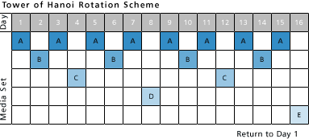
Tower of Hanoi
Media set "A" is used every other backup session
Start Day 1 with "A" and repeat every other backup (every other day)
Media set "B" starts on the first non-"A" backup day
Repeats every fourth backup session
Media set "C" starts on the first non-"A" or non-"B" backup day
Repeats every eighth session
Media set "D" starts on the first non-"A," non-"B," or non-"C" backup day
Repeats every sixteenth session
Media set "E" alternates with media set "D"
Advantage to the Tower of Hanoi scheme:
For each new media set added to the rotation, the backup history doubles
Frequently used media sets have the most recent copies of a file
Less frequently used media retain older versions
This backup scheme can be difficult to keep track of manually
Generally done with the help of rotation schemes provided in backup software packages

Slide 19
Storage media

Slide 20
Storage media
Regardless of repository model used:
Data has to be stored on some data storage medium somewhere

Slide 21
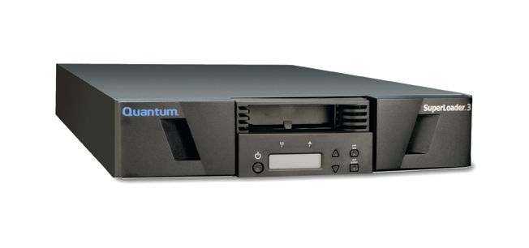
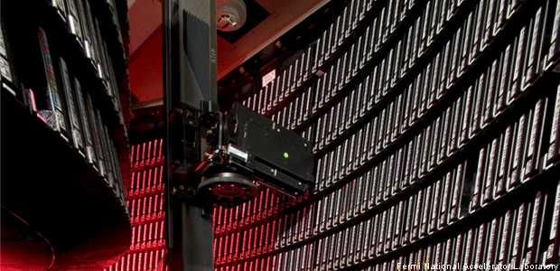
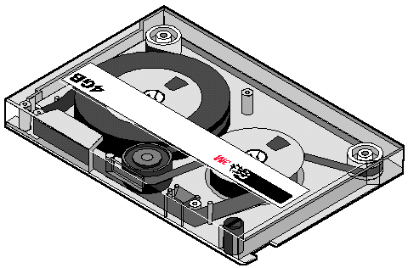
Tape backup
Reel-to-reel
Manual
Cartridge
Automated
Robot

Slide 22
Storage media
Magnetic tape
Has long been the most commonly used medium for:
Bulk data storage
Backup
Archiving
Interchange
Tape historically:
Order of magnitude better capacity/price ratio when compared to hard disk
Recently the ratios for tape and hard disk have become a lot closer

Slide 23
Storage cost circa 2007

Slide 24
Current LTO status
~$100 (2017)

Slide 25
Storage media
Magnetic tape
Myriad of formats
Many are proprietary or specific to certain markets
e.g. mainframes or a particular brand of personal computer
LTO seems to be the current favorite (open standard)
T10000 (Storage Tek)
TS series (IBM)
Tape is a sequential access medium
Access times may be poor
Especially random access
Rate of continuously writing or reading data can actually be very fast
Some new tape drives are even faster than modern hard disks (streaming)

Slide 26
Hard disk

Slide 27
Storage media
Hard disk
Capacity/price ratio of hard disk has been rapidly improving for many years
Making it more competitive with magnetic tape as a bulk storage medium
Main advantages of hard disk storage are low access times, availability, capacity and ease of use

Slide 28
Storage media
Hard disk
External disks can be connected via:
Local interfaces like SCSI, USB or FireWire
Longer distance technologies like Ethernet, iSCSI, or Fibre Channel
Some disk-based backup systems support data de-duplication which can dramatically reduce the amount of disk storage capacity consumed by daily and weekly backup data
e.g Virtual Tape Libraries

Slide 29
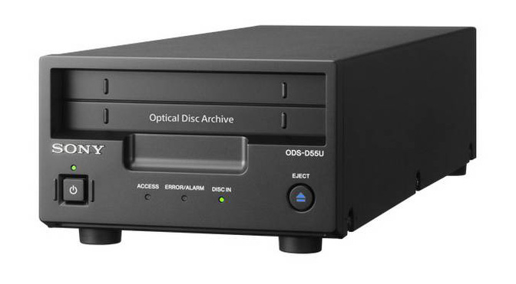
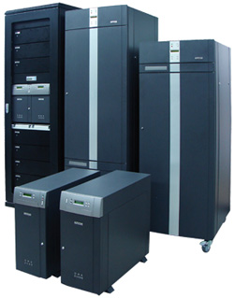
Optical Disk

Slide 30
Storage media
Optical disc
Recordable CD/DVD/Blu-ray can be used as a backup device
Advantages of optical drives is that they can be restored on any machine with a commonly compatible drive
In addition, recordable CD's and DVD’s are relatively cheap
Blu-ray is getting there

Slide 31
Storage media
Optical disc
Many optical disk formats are WORM type
Makes them useful for archival purposes
Data can't be changed once written
Other rewritable formats can also be utilized
CDRW
DVD-RAM
BluRay Disks dramatically increase the amount of data possible on a single optical storage disk

Slide 32
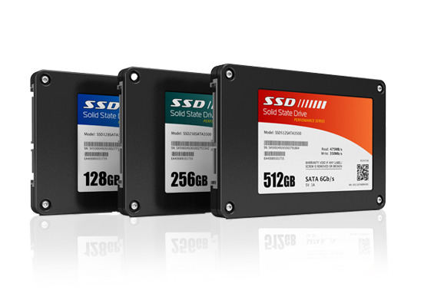
Solid state

Slide 33
Storage media
Solid state storage
Portable
Also known as flash memory, thumb drives, USB flash drives, CompactFlash, SmartMedia, Memory Stick, Secure Digital cards, etc.
These devices are relatively costly for their low capacity, but offer excellent portability, speed, and ease-of-use
Hard Drive replacement
Fast
Low power

Slide 34
Other

Slide 35
Storage media - other
Floppy disk
During the 1980s and early 1990s, many personal/home computer users associated backup mostly with copying floppy disks
Low data capacity of a floppy disk makes it an unpopular and obsolete choice today

Slide 36
Storage media - other
Remote backup service
As broadband internet access becomes more widespread, remote backup services are gaining in popularity
Backing up via the internet to a remote location can protect against some worst-case scenarios such as fire, flood, earthquake or nuclear strike which would destroy any backups in the immediate vicinity along with everything else
Downsides:
Internet connections are typically much slower than the speed of local data storage devices
Can be a problem for people with large amounts of data
Risk associated with putting control of personal or sensitive data in the hands of a third party

Slide 37
Managing the data repository

Slide 38
Managing the data repository
Regardless of the data repository model or data storage media used for backups, a balance needs to be struck between
Accessibility
Security
Cost

Slide 39
Managing the data repository
On-line backup storage
Typically the most accessible type of data storage
Can begin restores in milliseconds
Example: an internal hard disk or a disk array (maybe connected to SAN).
Very convenient and speedy
But is typically relatively expensive
Vulnerable to being deleted or overwritten
By accident
In the wake of a data-deleting virus payload

Slide 40
Managing the data repository
Near-line
Typically less accessible and less expensive than on-line storage
Still useful for backup data storage
Example: a tape library with restore times ranging from seconds to a few minutes
A mechanical device is usually involved in moving media units from storage into a drive where the data can be read or written

Slide 41
Managing the data repository
Off-line
Similar to near-line
Requires human interaction to make storage media available
Can be as simple as storing backup tapes in a file cabinet
Typical media access time is more than an hour

Slide 42
Managing the data repository
Off-site vault
To protect against a disaster or other site-specific problem, many people choose to send backup media to an off-site vault
The vault can be:
Simple as the System Administrator’s home office
-- or --
Sophisticated as a disaster hardened, temperature controlled, high security bunker that has facilities for backup media storage

Slide 43
Managing the data repository
Backup site, Disaster Recovery Center (DR Center)
In the event of a major disaster, the data on backup media may not be sufficient to recover
Computer systems onto which the data can be restored and properly configured networks are necessary too
Some organizations have their own data recovery centers that are equipped for this scenario
Other organizations contract this out to a third-party recovery center
Note that because DR site is itself a huge investment, backup is very rarely considered preferred method of moving data to DR site
More typical way would be remote disk mirroring, which keeps the DR data as up-to-date as possible

Slide 44
Selection, extraction and manipulation of data

Slide 45
Selection and extraction of file data
Deciding what to back up at any given time is non-trivial
Backing up too much or redundant data
Data repository will fill up too quickly
Waste time
Waste $$$
Not backing up enough data
Critical information can get lost

Slide 46
Selection and extraction of file data
Key concept: only back up important files that have changed
Copying files
Copy the files to be backed up to another location
Typically uses the OS specific copy utility
Filesystem dump
Copy the filesystem that holds the files in question to another location
Usually involves unmounting the filesystem and running a program like dump
Also known as a raw partition backup.
Can run faster than a backup that simply copies files
Some dump software allows the restore specific files from the dump image

Slide 47
Selection and extraction of file data
Key concept: only back up important files that have changed
Identification of changes
Some filesystems have an archive bit for each file that says it was recently changed
Some backup software looks at the date of the file and compares it with the last backup, to determine whether the file was changed
Block Level Incremental
More sophisticated method of backing up changes to files is to only back up the blocks within the file that changed
Requires a higher level of integration between the filesystem and the backup software
Versioning file system
Keeps track of all changes to a file and makes those changes accessible to the user
Generally this gives access to any previous version, all the way back to the file's creation time
An example of this is the Wayback versioning filesystem for Linux

Slide 48
Selection and extraction of live data

Slide 49
Selection and extraction of live data
If a computer system is in use while it is being backed up, the possibility of files being open for reading or writing can present a problem
If a file is open, the contents on disk may not correctly represent what the owner of the file intends
This is especially true for database files of all kinds

Slide 50
Selection and extraction of live data
When attempting to understand the logistics of backing up open files:
Backup process could take several minutes to back up a large file
To back up a file that is in use
It is vital that the entire backup represent a single-moment snapshot of the file?
Rather than a simple copy of a read-through
Represents a challenge when backing up a file that is constantly changing
Either the database file:
Must be locked to prevent changes
A method must be implemented to ensure that the original snapshot is preserved long enough to be copied, all while changes are being preserved.
Backing up a file while it is being changed, in a manner that causes the first part of the backup to represent data before changes occur to be combined with later parts of the backup after the change results in a corrupted file that is unusable, as most large files contain internal references between their various parts that must remain consistent throughout the file

Slide 51
Selection and extraction of live data
Snapshot backup
A snapshot is an instantaneous function of some storage systems that presents a copy of the filesystem as if it was frozen in a specific point in time, often by a copy-on-write mechanism
An effective way to back up live data is to temporarily quiesce it (e.g. close all files), take a snapshot, and then resume live operations
At this point the snapshot can be backed up through normal methods.
While a snapshot is very handy for viewing a filesystem as it was at a different point in time, it is hardly an effective backup mechanism by itself.
Open file backup
Many backup software packages feature the ability to back up open files
Some simply check for openness and try again later
File locking is useful for regulating access to open files
Cold database backup
During a cold backup, the database is closed or locked and not available to users
Datafiles do not change during the copy so the database is in sync upon restore
Hot database backup
Some database management systems offer a means to generate a backup image of the database while it is online and usable ("hot")
This usually includes an inconsistent image of the data files plus a log of changes made while the procedure is running
Upon a restore, the changes in the log files are reapplied to bring the database in sync

Slide 52
Selection and extraction of metadata

Slide 53
Selection and extraction of metadata
Not all information stored on the computer is stored in the files itself
Accurately recovering a complete system from scratch requires keeping track of this non-data information also
System description
System specifications are needed to procure an exact replacement after a disaster
File metadata
Each file's permissions, owner, group, ACLs, and any other metadata need to be backed up for a restore to properly recreate the original environment
Partition layout
The layout of the original disk, as well as partition tables and file system settings, is needed to properly recreate the original system
Boot sector
Boot sector can sometimes be recreated more easily than saving it
Still, it usually isn't a normal file and the system won't boot without it

Slide 54
Manipulation of data

Slide 55
Manipulation of data
Useful to manipulate the data being backed up
Can optimize the backup process
Can improve:
Backup speed
Restore speed
Data security
Media usage

Slide 56
Manipulation of data
Compression
Shrink the size of the source data to be stored
→ uses less storage space
Compression is frequently a built-in feature of tape drive hardware
Duplication
Sometimes backup jobs are temporarily duplicated to a second set of storage media
Allows rearranging the backup images to:
Optimize restore speed
Have a second copy at a different location
Put on a different storage medium

Slide 57
Manipulation of data
De-duplication
Multiple similar systems are backed up to the same destination storage device
Exists the potential for much redundancy within the backed up data
For example, if 20 Windows 7 workstations were backed up to the same data repository, they might share a common set of system files
Data repository only needs to store one copy of those files to be able to restore any one of those workstations
Technique scan be applied at the file level or even on raw blocks of data, potentially resulting in a massive reduction in required storage space
"Client" side
Before any data moves to backup media
Sometimes referred to as source/client side de-duplication
Reduces bandwidth required to send backup data to its target media
"Server" side
Done at the target storage device
Sometimes referred to as inline or back-end de-duplication

Slide 58
Manipulation of data
Encryption
Removable storage media such as backup tapes
Present a data security risk if they are lost or stolen
Encrypting the data can mitigate this problem
Presents new problems
Encryption can slow down backup speeds
Encrypted can not be effectively compressed
Redundant data makes cryptanalytic attacks easier
Many encryption routines compress the data as an integral part of the encryption process
Security of the encrypted backups is only as effective as the security of the key management policy

Slide 59
Manipulation of data
Staging
Backup jobs are copied to a staging disk before being copied to tape
Sometimes referred to as D2D2T
Acronym for Disk to Disk to Tape
Useful if there is a problem matching the speed of the final destination device with the source device
Typically true in network-based backup systems
Can also serve as a centralized location for applying other data manipulation techniques

Slide 60
Managing the backup process

Slide 61
Managing the backup process
Important to understand backing up is a process
As long as new data is being created and changes are being made, backups will need to be updated
Individuals and organizations with anything from one computer to thousands (or even millions) of computer systems all have requirements for protecting data
While the scale is different, the objectives and limitations are essentially the same
Likewise, those who perform backups need to know to what extent they were successful, regardless of scale

Slide 62
Objectives

Slide 63
Objectives
Recovery Point Objective (RPO)
Point in time that the restarted infrastructure will reflect
Essentially, this is the roll-back that will be experienced as a result of the recovery
The most desirable RPO would be the point just prior to the data loss event
Making a more recent recovery point achievable requires increasing the frequency of synchronization between the source data and the backup repository

Slide 64
Objectives
Recovery Time Objective (RTO)
Amount of time elapsed between disaster and restoration of business functions
Data security
In addition to preserving access to data for its owners, data must be restricted from unauthorized access
Backups must be performed in a manner that does not compromise the original owner's undertaking
Can be achieved with data encryption and proper media handling policies

Slide 65
Limitations
System impacts
An effective backup scheme will take into consideration the limitations of the situation
All backup schemes have some impact on the system being backed up
If this impact is significant, the backup needs to be time-limited to a convenient backup window or alternate means of protecting data need to be employed
These alternate means tend to be more expensive
Costs of hardware, software, labor
All types of storage media have a finite capacity with a real cost
Matching the correct amount of storage capacity (over time) with the backup needs is an important part of the design of a backup scheme
Any backup scheme has some labor requirement, but complicated schemes have considerably higher labor requirements
The cost of commercial backup software can also be considerable
Network Bandwidth
Distributed backup systems can be impacted by limited network bandwidth

Slide 66
Implementation
Meeting the defined objectives in the face of the above limitations can be a difficult task
The tools and concepts below can make that task more achievable
Scheduling
Using a job scheduler can greatly improve the reliability and consistency of backups by removing part of the human element
Many backup software packages include this functionality
Authentication
Over the course of regular operations, the user accounts and/or system agents that perform the backups need to be authenticated at some level
The power to copy all data off of or onto a system requires unrestricted access
Using an authentication mechanism is a good way to prevent the backup scheme from being used for unauthorized activity
Chain of trust
Removable storage media are physical items and must only be handled by trusted individuals
Establishing a chain of trusted individuals (and vendors) is critical to defining the security of the data

Slide 67
Measuring the process
To ensure that the backup scheme is working as expected:
Process needs to include monitoring key factors
Maintain historical data

Slide 68
Measuring the process
Backup validation
Process by which owners of data can get information regarding how their data was backed up
Process is also used to prove compliance to regulatory bodies outside of the organization
For example, an insurance company might be required under HIPAA to show "proof" that their patient data are meeting records retention requirements
Disaster, data complexity, data value and increasing dependence upon ever-growing volumes of data all contribute to the anxiety around and dependence upon successful backups to ensure business continuity
Many organizations rely on third-party or "independent" solutions to test, validate, and optimize their backup operations

Slide 69
Measuring the process
Reporting
Reports are useful for monitoring media usage, device status, errors, vault coordination and other information about the backup process
Especially in larger configurations
Logging
In addition to the history of computer generated reports, activity and change logs are useful for monitoring backup system events

Slide 70
Measuring the process
Validation
Many backup programs make use of checksums or hashes to validate that the data was accurately copied
These offer several advantages:
Allows data integrity to be verified without reference to the original file:
If the file as stored on the backup medium has the same checksum as the saved value, then it is very probably correct
Some backup programs can use checksums to avoid making redundant copies of files, to improve backup speed.
This is particularly useful for the de-duplication process
Monitored Backup
Backup processes are monitored by a third party monitoring center
This center alerts users to any errors that occur during automated backups
Monitored backup requires software capable of pinging the monitoring center's servers in the case of errors

Slide 71
Wrapup/Lore

Slide 72
3-2-1 rule
At least 3 copies
Copies are “cheap”
Can store in different locations
One copy is good
Just not good enough
In 2 different formats or mediums
USB, CDs, tapes, etc.
Guards against a technology type failure or obsolescence
Mitigates risk of a type of copy being corrupted
With 1 copy off-site
FAR AWAY!
Local copy allows speed of recovery
Remote copy incase of a large scale local disaster
E.g. fire, flood, earthquake, tornado

Slide 73
Advice
The more important the data that stored on the computer the greater the need for backing up the data
A backup is only as useful as its associated restore strategy
Storing the only copy near the original is unwise
Many disasters such as fire, flood and electrical surges are likely to cause damage to the backup at the same time
Automated backup and scheduling should be considered
Manual backups can be affected by human error
Backups will fail for a wide variety of reasons
A verification or monitoring strategy is an important part of a successful backup plan

Slide 74
Lore
Events
In 1996, during a fire at the headquarters of Credit Lyonnais, a major bank in Paris, system administrators ran into the burning building to rescue backup tapes
They didn't have offsite copies
Crucial bank archives and computer data were lost
Privacy Rights Clearinghouse has documented 16 instances of stolen or lost backup tapes (among major organizations) in 2005 & 2006
Affected organizations included Bank of America, Ameritrade, Citigroup, and Time Warner

Slide 75
What is most important to back up (select one or more):
The OS
Critical programs (eg Excel or Word)
User data (eg Word documents)
Databases

Slide 76
Glossary of backup terms

Slide 77
Glossary of backup terms
Backup policy
An organisation's procedures and rules for ensuring that adequate amounts and types of backups are made, including suitably frequent testing of the process for restoring the original production system from the backup copies
Backup rotation scheme
A method for effectively backing up data where multiple media are systematically moved from storage to usage in the backup process and back to storage
There are several different schemes. Each takes a different approach to balance the need for a long retention period with frequently backing up changes. Some schemes are more complicated than others
Backup site
A place where business can continue after a data loss event. Such a site may have ready access to the backups or possibly even a continuously updated mirror
Backup software
Computer software applications that are used for performing the backing up of data, i.e., the systematic generation of backup copies
Backup window
The period of time that a system is available to perform a backup procedure. Backup procedures can have detrimental effects to system and network performance, sometimes requiring the primary use of the system to be suspended.
These effects can be mitigated by arranging a backup window with the users or owners of the system(s)

Slide 78
Glossary of backup terms
Copy backup
Term for full backup used by Windows Server 2003
Cumulative incremental backup
Term for a differential backup used by NetBackup
Daily backup
Term for incremental backup used by Windows Server 2003
Data salvage
The process of recovering data from storage devices when the normal operational methods are impossible. This process is typically performed by specialists in controlled environments with special tools. For example, a crashed hard disk may still have data on it even though it doesn't work properly. A data salvage specialist might be able to recover much of the original data by opening it up in a clean room and tinkering with the internal parts
Differential backup
A cumulative backup of all changes made since the last full backup. The advantage to this is the quicker recovery time, requiring only a full backup and the latest differential backup to restore the system. The disadvantage is that for each day elapsed since the last full backup, more data needs to be backed up, especially if a majority of the data has been changed
Differential incremental backup
Term for an incremental backup used by NetBackup
Disaster recovery
The process of recovering after a business disaster and restoring or recreating data. One of the main purposes of creating backups is to facilitate a successful disaster recovery. For maximum effectiveness, this process should be planned in advance and audited
Disk image
A method of backing up a whole disk or filesystem in a single image. Since the underlying data structures are what is actually backed up, this method does not allow for file level control over what is selected for backup or restore

Slide 79
Glossary of backup terms
FlashBackup
Term for raw partition backup used by NetBackup Advanced Client. In NBAC, support is limited to the VxFS (Veritas), ufs (Solaris), Online JFS (HP-UX), and NTFS (Windows) filesystem types. Similar to the UNIX utility dump.
Full backup
A backup of all (selected) files on the system. In contrast to a drive image, this does not included the file allocation tables, partition structure and boot sectors.
Hot backup
A backup of a database that is still running, and so changes may be made to the data while it is being backed up. Some database engines keep a record of all entries changed, including the complete new value. This can be used to resolve changes made during the backup.
Incremental backup
A backup that only contains the files that have changed since the most recent backup (either full or incremental). The advantage of this is quicker backup times, as only changed files need to be saved. The disadvantage is longer recovery times, as the latest full backup, and all incremental backups up to the date of data loss need to be restored.
Media spanning
Sometimes a backup job is larger than a single destination storage medium. In this case, the job must be broken up into fragments that can be distributed across multiple storage media.
Multiplexing
The practice of combining multiple backup data streams into a single stream that can be written to a single storage device. For example, backing up 4 PCs to a single tape drive at once.
Multistreaming
The practice of creating multiple backup data streams from a single system to multiple storage devices. For example, backing up a single database to 4 tape drives at once.

Slide 80
Glossary of backup terms
Normal backup
Term for full backup used by Windows Server 2003.
Near store
Provisionally backing up data to a local staging backup device, possibly for later archival backup to a remote store device.
Open file backup
Term for the ability to back up a file while it is in use by another application. See File locking.
Remote store
Backing up data to an offsite permanent backup facility, either directly from the live data source or else from an intermediate near store device.
Restore time
The amount of time required to bring a desired data set back from the backup media.
Retention time
The amount of time in which a given set of data will remain available for restore. Some backup products rely on daily copies of data and measure retention in terms of days. Others retain a number of copies of data changes regardless of the amount of time.
Site-to-site backup
Backup, over the internet, to an offsite location under the user's control. Similar to remote backup except that the owner of the data maintains control of the storage location.
Synthetic backup
Term used by NetBackup for a restorable backup image that is synthesized on the backup server from a previous full backup and all the incremental backups since then. It is equivalent to what a full backup would be if it were taken at the time of the last incremental backup.

Slide 81
Glossary of backup terms
Tape library
A storage device which contains tape drives, slots to hold tape cartridges, a barcode reader to identify tape cartridges and an automated method for physically moving tapes within the device. These devices can store immense amounts of data.
True image restore
Term used by NetBackup and Backup Exec for the collection of file deletion and file movement records so that an accurate restore can be performed. For instance, consider a system that has a directory with 5 documents in it on Friday. On Saturday, the system gets a full backup that includes those 5 documents. On Monday, the owner of those documents deletes 2 of them and updates 1 of the 3 remaining. That updated document gets backed up as part of The Monday night incremental backup. On Tuesday afternoon the system crashes. If we perform a normal restore of the full backup from Saturday and the incremental backup from Monday to the fresh system, we will have restored the 2 documents that were intentionally deleted. True image restore keeps track of the deletions with each incremental backup and prevents the deleted files from being inappropriately restored.
Trusted paper key
A machine-readable print of a cryptographic key.
Virtual Tape Library (VTL)
A storage device that appears to be a tape library to backup software, but actually stores data by some other means
A VTL can be configured as a temporary storage location before data is actually sent to real tapes or it can be the final storage location itself

