Slide 1
Networks and TCP/IP
Part 2 - Transport

Slide 2
Ports

Slide 3
Ports – What and Why are They?
Typically:
Computers usually have only one network access point to the internet
e.g. one NIC card
Multiple systems and programs on the computer want to access the network/internet
To receive and send data
For THEIR application
How do programs and systems keep their conversations straight?

Slide 4
Ports
An extra 16 bit field
Added to the end of the IP address
16 bits → 65536 values
0-65535
E.g. 192.168.1.2:8080
Denotes the source or destination application
Not all transport layers use ports
TCP and UDP do
These send data between devices
ICMP does not
Sends info about the network

Slide 5
Common Ports
Port # | Common Protocol | Service |  | Port # | Common Protocol | Service
7 | TCP | echo |  | 80 | TCP | http
9 | TCP | discard |  | 110 | TCP | pop3
13 | TCP | daytime |  | 111 | TCP | sunrpc
19 | TCP | chargen |  | 119 | TCP | nntp
20 | TCP | ftp-control |  | 123 | UDP | ntp
21 | TCP | ftp-data |  | 137 | UDP | netbios-ns
23 | TCP | telnet |  | 138 | UDP | netbios-dgm
25 | TCP | smtp |  | 139 | TCP | netbios-ssn
37 | UDP | time |  | 143 | TCP | imap
43 | TCP | whois |  | 161 | UDP | snmp
53 | TCP/UDP | dns |  | 162 | UDP | snmp-trap
67 | UDP | bootps |  | 179 | TCP | bgp
68 | UDP | bootpc |  | 443 | TCP | https (http/ssl)
69 | UDP | tftp |  | 520 | UDP | rip
70 | TCP | gopher |  | 1080 | TCP | socks
79 | TCP | finger |  | 33434 | UDP | traceroute

Slide 6
Transport Protocols

Slide 7
Transport Protocols
TCP, UDP, et al.
TCP
Transmission Control Protocol
More complicated
Ensures delivery
UDP
User Datagram Protocol
Simpler protocol
Delivery not guaranteed
Others
DCCP
Datagram Congestion Control Protocol
SCTP
Stream Control Transmission Protocol

Slide 8
TCP
Transmission Control Protocol

Slide 9
TCP – Transmission Control Protocol
One of the protocols on how data may be transmitted between addresses
TCP:
Data broken into packets
Each is numbered
Each packet sent most “practical” way at that moment
Traffic
Network/Router Failures
Etc.
Reassembled at destination

Slide 10
TCP
TCP adds a great deal of functionality to the IP service it is layered over:
Streams
TCP data is organized as a stream of bytes, much like a file
Datagram nature of the network is concealed
A mechanism (the Urgent Pointer) exists to let out-of-band data be specially flagged
Reliable delivery
Sequence numbers used to coordinate which data has been transmitted and received
TCP will arrange for retransmission if it determines that data has been lost
Network adaptation
Dynamically learn the delay characteristics of a network
Adjusts its operation to maximize throughput without overloading the network
Flow control
TCP manages data buffers, and coordinates traffic so its buffers will never overflow
Fast senders will be stopped periodically to keep up with slower receivers

Slide 11
TCP Header (historical)
TCP Header Format
0 1 2 3
0 1 2 3 4 5 6 7 8 9 0 1 2 3 4 5 6 7 8 9 0 1 2 3 4 5 6 7 8 9 0 1
+-+-+-+-+-+-+-+-+-+-+-+-+-+-+-+-+-+-+-+-+-+-+-+-+-+-+-+-+-+-+-+-+
| Source Port | Destination Port |
+-+-+-+-+-+-+-+-+-+-+-+-+-+-+-+-+-+-+-+-+-+-+-+-+-+-+-+-+-+-+-+-+
| Sequence Number |
+-+-+-+-+-+-+-+-+-+-+-+-+-+-+-+-+-+-+-+-+-+-+-+-+-+-+-+-+-+-+-+-+
| Acknowledgment Number |
+-+-+-+-+-+-+-+-+-+-+-+-+-+-+-+-+-+-+-+-+-+-+-+-+-+-+-+-+-+-+-+-+
| Data | |U|A|P|R|S|F| |
| Offset| Reserved |R|C|S|S|Y|I| Window |
| | |G|K|H|T|N|N| |
+-+-+-+-+-+-+-+-+-+-+-+-+-+-+-+-+-+-+-+-+-+-+-+-+-+-+-+-+-+-+-+-+
| Checksum | Urgent Pointer |
+-+-+-+-+-+-+-+-+-+-+-+-+-+-+-+-+-+-+-+-+-+-+-+-+-+-+-+-+-+-+-+-+
| Options | Padding |
+-+-+-+-+-+-+-+-+-+-+-+-+-+-+-+-+-+-+-+-+-+-+-+-+-+-+-+-+-+-+-+-+
| data |
+-+-+-+-+-+-+-+-+-+-+-+-+-+-+-+-+-+-+-+-+-+-+-+-+-+-+-+-+-+-+-+-+

Slide 12
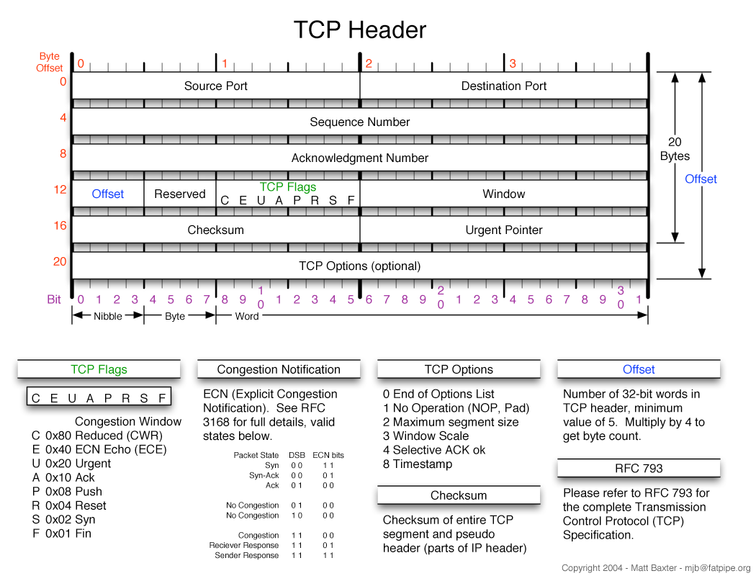
TCP Header – Prettier!

Slide 13
UDP Header
1 1 1 1 1 1 1 1 1 1 2 2 2 2 2 2 2 2 2 2 3 3
0 1 2 3 4 5 6 7 8 9 0 1 2 3 4 5 6 7 8 9 0 1 2 3 4 5 6 7 8 9 0 1
+-+-+-+-+-+-+-+-+-+-+-+-+-+-+-+-+-+-+-+-+-+-+-+-+-+-+-+-+-+-+-+-+
| Source Port | Destination Port |
+-+-+-+-+-+-+-+-+-+-+-+-+-+-+-+-+-+-+-+-+-+-+-+-+-+-+-+-+-+-+-+-+
| Length | Checksum |
+-+-+-+-+-+-+-+-+-+-+-+-+-+-+-+-+-+-+-+-+-+-+-+-+-+-+-+-+-+-+-+-+
| Data...
+-+-+-+-+-+-+-+-+-+-+-+-+-

Slide 14
Handy Tools

Slide 15
Ping
Answers the age old question: Is anybody out there?
Typically uses ICMP (Internet Control Message Protocol)
To use:
ping ip.ad.dr.ess
E.g.
ping 152.15.95.88
ping www.hp.com
Sample return if address found:
Reply from 152.15.95.88: bytes=32 time<1ms TTL=63
Confirms address
Bytes sent
How long it took
Time To Live (TTL)
If not found:
Request timed out
Caution:
Some systems will ping forever until command is terminated (usually with a Ctrl-C)
Linux, Unix, Mac OS
Some systems will not echo failed pings until command is terminated

Slide 16
Ping
Uses echo request
Many sites will no longer answer a ping request
Worry it can be used by worms for reconnaissance
Can be used for DDoS attacks
Distributed Denial of Service

Slide 17
Ping – Windows example
C:\>ping ctc.net
Pinging ctc.net [166.82.1.97] with 32 bytes of data:
Reply from 166.82.1.97: bytes=32 time=24ms TTL=122
Reply from 166.82.1.97: bytes=32 time=23ms TTL=122
Reply from 166.82.1.97: bytes=32 time=23ms TTL=122
Reply from 166.82.1.97: bytes=32 time=36ms TTL=122
Ping statistics for 166.82.1.97:
Packets: Sent = 4, Received = 4, Lost = 0 (0% loss),
Approximate round trip times in milli-seconds:
Minimum = 23ms, Maximum = 36ms, Average = 26ms
Executed: ping ctc.net
Note the address can be an IP address or a DNS name
Replied it was pinging 166.82.1.97
Time it took to echo (23-36 ms)
TTL (Time To Live) of 122
How many hops left before packet expires
Recommended default starting TTL is now 64
Can be up to 255
Different systems have different defaults
Windows does 4 pings and quits

Slide 18
Ping – Linux example
PING ctc.net (162.39.145.20) 56(84) bytes of data.
64 bytes from www2.windstream.net (162.39.145.20): icmp_req=1 ttl=50 time=40.0 ms
64 bytes from www2.windstream.net (162.39.145.20): icmp_req=2 ttl=50 time=40.2 ms
64 bytes from www2.windstream.net (162.39.145.20): icmp_req=3 ttl=50 time=40.0 ms
64 bytes from www2.windstream.net (162.39.145.20): icmp_req=4 ttl=50 time=40.9 ms
64 bytes from www2.windstream.net (162.39.145.20): icmp_req=5 ttl=50 time=39.9 ms
--- ctc.net ping statistics ---
5 packets transmitted, 5 received, 0% packet loss, time 4005ms
rtt min/avg/max/mdev = 39.966/40.252/40.905/0.407 ms
Executed: ping ctc.net
Actually:
ping ctc.net > ping.txt
<Ctrl>-C after 5 seconds
copied ping.txt file contents to this slide
Note the Debian Linux ping returns DNS name and IP address
Replied it was pinging 162.39.145.20
Time it took to echo (39.9-40.2 ms)
TTL (Time To Live) of 50
How many hops left before packet expires
Recommended default starting TTL is now 64
Can be up to 255
Different systems have different defaults for TTL
As a default, Linux pings forever
Must <Ctrl>-C to exit

Slide 19
Trace Route
“Pings” and reports the paths taken
Windows:
tracert [options] target_name
Linux:
traceroute [options] host

Slide 20
Traceroute
How it works:
Pings with TTL=1
Reports how long ping took until TTL=0
Pings with TTL=2
Reports how long ping took until TTL=0
…
Final ping that reached the destination
Reports how long successful ping took
Has a typical max hops of 30
Times may vary
Not guaranteed of same route every ping
Not guaranteed same traffic every ping

Slide 21
Trace Route Examples (Windows)
C:\>tracert google.com
Tracing route to google.com [72.14.207.99]
over a maximum of 30 hops:
1 1 ms 1 ms <1 ms 192.168.1.1
2 46 ms 46 ms 43 ms 166.82.149.1
3 46 ms 61 ms 47 ms t3-3.cr02.knpl.ctc.net [166.82.4.41]
4 24 ms 25 ms 29 ms t8-2.cr01.cncr.ctc.net [166.82.3.25]
5 23 ms 27 ms 23 ms g5-1.bd01.cncr.ctc.net [166.82.3.90]
6 41 ms 39 ms 39 ms sl-gw21-atl-6-3.sprintlink.net [144.228.100.81]
7 42 ms 47 ms 41 ms sl-bb23-atl-5-0.sprintlink.net [144.232.12.17]
8 38 ms 42 ms 39 ms sl-bb24-atl-15-0.sprintlink.net [144.232.12.6]
9 39 ms 41 ms 39 ms sl-st20-atl-0-0-0.sprintlink.net [144.232.20.115]
10 39 ms 42 ms 39 ms 144.223.47.234
11 44 ms 44 ms 44 ms 64.233.174.86
12 53 ms 61 ms 60 ms 66.249.95.148
13 84 ms 71 ms 72 ms 72.14.238.234
14 68 ms 72 ms 74 ms 216.239.46.12
15 71 ms 72 ms 73 ms 72.14.233.115
16 69 ms 82 ms 81 ms 66.249.94.118
17 83 ms 75 ms 74 ms 66.249.94.50
18 71 ms 69 ms 73 ms eh-in-f99.google.com [72.14.207.99]
Trace complete.

Slide 22
Trace Route Examples(Windows) to my ISP – ctc.net to my local network – “home”
C:\>tracert myctc.net
Tracing route to myctc.net [166.82.12.17]
over a maximum of 30 hops:
1 1 ms <1 ms <1 ms 192.168.1.1
2 154 ms 27 ms 207 ms 166.82.149.1
3 24 ms 25 ms 24 ms t3-3.cr02.knpl.ctc.net [166.82.4.41]
4 24 ms 24 ms 23 ms t8-2.cr01.cncr.ctc.net [166.82.3.25]
5 23 ms 25 ms 27 ms t9-1.ce01.cncr.ctc.net [166.82.3.10]
6 24 ms 25 ms 28 ms myctc.net [166.82.12.17]
7 40 ms 23 ms 23 ms myctc.net [166.82.12.17]
Trace complete.
C:\>tracert 192.168.1.32
Tracing route to 192.168.1.32 over a maximum of 30 hops
1 2 ms <1 ms 1 ms 192.168.1.32
Trace complete.

Slide 23
Trace Route Example (Linux)
#traceroute google.com
login as: tkombol
traceroute to google.com (64.233.185.113), 30 hops max, 60 byte packets
1 r06-v143-gw.uncc.edu (10.18.198.1) 0.285 ms 0.266 ms 0.492 ms
2 r06-to-wood-po53.uncc.edu (10.0.36.130) 0.483 ms 0.972 ms 0.975 ms
3 perim-to-asa-legacy.uncc.edu (10.0.1.83) 0.959 ms 0.942 ms 0.946 ms
4 pa5060-perim-1.uncc.edu (152.15.249.10) 1.572 ms 1.552 ms 1.864 ms
5 atkig20-inet-6504-1.uncc.edu (152.15.249.5) 1.536 ms 1.527 ms 1.508 ms
6 ws-a1a-ip-asr-gw-to-uncc-atkins.ncren.net (128.109.1.17) 3.998 ms 3.712 ms 3.699 ms
7 wscrs-gw-to-ws-a1a-ip-asr-gw.ncren.net (128.109.1.101) 5.174 ms 6.024 ms
8 72.14.196.245 (72.14.196.245) 28.435 ms 28.416 ms 28.396 ms
9 72.14.233.54 (72.14.233.54) 10.393 ms 72.14.233.56 (72.14.233.56) 10.130 ms 72.14.233.54 (72.14.233.54) 10.108 ms
10 66.249.94.20 (66.249.94.20) 10.845 ms 216.239.51.243 (216.239.51.243) 10.847 ms 209.85.142.140 (209.85.142.140) 10.326 ms
11 209.85.143.201 (209.85.143.201) 10.815 ms 209.85.142.157 (209.85.142.157) 10.424 ms 209.85.143.201 (209.85.143.201) 10.414 ms
12 * * *
13 yb-in-f113.1e100.net (64.233.185.113) 10.563 ms 10.688 ms 10.991 ms

Slide 24
Resume 1/30

Slide 25
Hardware
Specialized Machines to Enable Networking

Slide 26
Hub, Switch, Router, Bridge, Repeater?
Hubs (Ethernet)
Pass data to all devices connected
Switches (Ethernet)
Pass data from sender to intended destination only
Must be in network
Works at MAC level
Router
Does “switching”
Looks for destinations outside network
Works at IP level
Bridge
Hooks dissimilar network protocols together
Token Ring → Ethernet
May or may not be on same network
Repeater
Amplifies, restores signal/strength

Slide 27
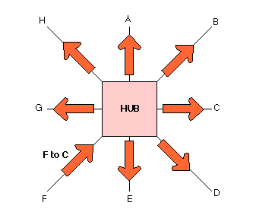
Hub
Receives signal on one port
Send to all ports
May be regenerated (amplified)
Immediate destination is on the same physical network
“Works” at MAC level
Hub doesn’t care about MACs

Slide 28
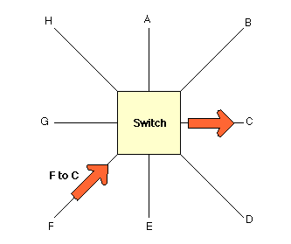
Switch
Receives signal on one port
Sends only to destination port
Immediate destination is on the same physical network
Works at MAC level
Switch keeps track of MAC addresses attached
Usually using a CAM
Content Addressable Memory

Slide 29
Notes
Both the Hub and Switch:
Work at the LAN level
Physical connections or networks
Allows computers close to other
Direct physical communication (electronic signals)
Hub
Sends signals to all ports on Hub
Switch
Sends signals only to the destination MAC
Warning
Note that the Logical Networks (Class A-E)
Only hosts in the same network (or subnet)
Can respond to each other
Even if they see the signals from another network

Slide 30
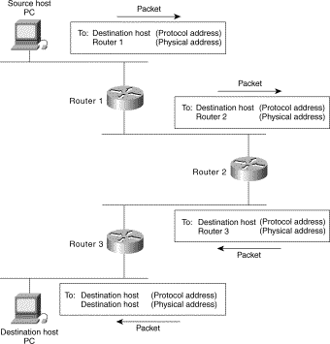
Router
Connects
Networks
Subnetworks
Finds a MAC address to get a packet closer to destination IP address
Next Router
Destination
Works at the IP level
Uses its local MAC addresses
What is the MAC address to send the data to get it (closer) to the destination IP
The data is sent out on that physical port

Slide 31
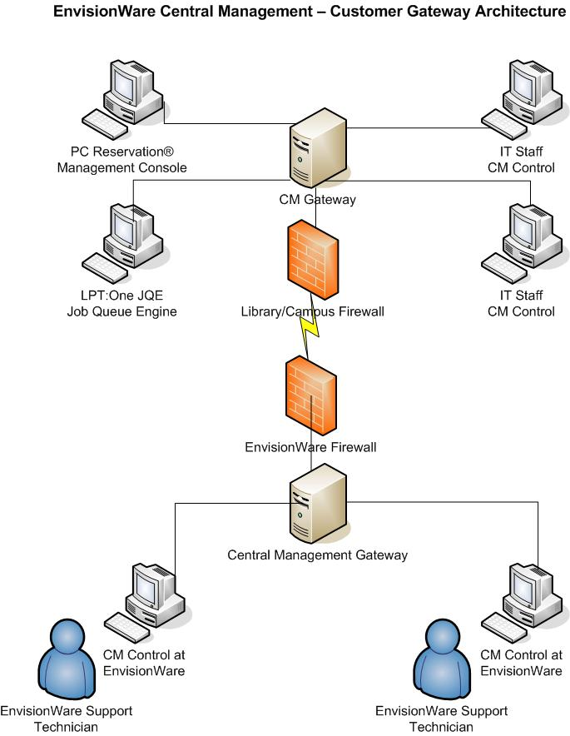
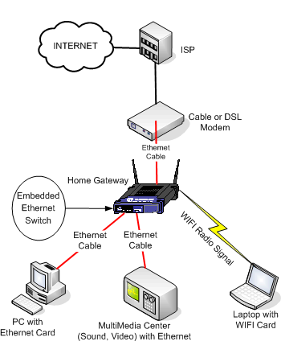
Gateway
Router on the edge of a network
Connects
LAN (Private networks)
-to-
WAN (Internet)
Home
Enterprise

Slide 32
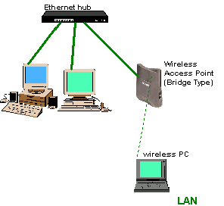
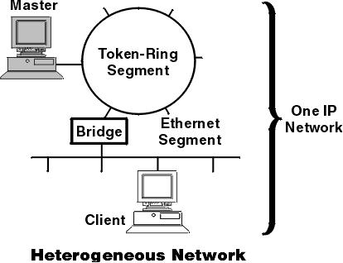
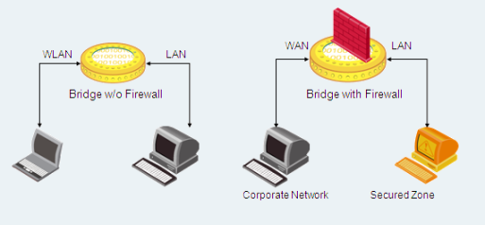
Bridge
Connects 2 dissimilar topologies
May or may not be same network
E.g. to connect:
Token Ring to Ethernet
ATM to Token Ring…
Usually does not filter traffic
Note:
Your wireless connections at home are actually bridged!

Slide 33
Proxies

Slide 34
Proxy Server
A server that acts as an intermediary for requests from clients seeking resources from other servers
May be a computer system or an application
Can keep machines anonymous (security)
May speed up access
Many types:
Caching Proxy Server
Web Proxy
Anonymizing proxy server
Hostile proxy (evil)
Intercepting proxy server

Slide 35
Caching Proxy Server
Saves results of previous requests
Local copies
Mainly for frequently used resources
Typically for Web applications
Serves these saved requests
Ensure they are properly implemented
Maximum performance

Slide 36
Web Proxy
Focuses on WWW traffic
Can filter or block
Can format for specific audiences
Cell phones
PDAs
Can be used to enforce/enhance
Network use policies
Malware interception
Caching

Slide 37
Anonymizing Proxy Server
Removes requestors identifying information

Slide 38
Hostile Proxy
Inserted between requestors and internet
For illegal/borderline purposes
Typically eavesdrops
Information is
Captured
Analyzed
Might be altered
Usually passed on to legitimate or original destination
Victim usually not aware of a hostile proxy

Slide 39
Intercepting Proxy Server
A.K.A. Transparent Proxy
Clients not aware it its existence
Combination proxy server and gateway
Can be used to:
Prevent circumventing use policy
Ease administrative burden
Etc.

Slide 40
Transparent and Non-transparent Proxy Servers
Transparent
Does not modify requests other than that needed for proxy authentication and identification
Non-transparent
Modifies requests and responses to provide “added” service
Annotation services
Protocol reduction
Anonymity filtering

Slide 41
Split Proxy Server
Implemented by
2 programs
On 2 computers
Good for
Compressing data over a slow link
Security

Slide 42
Reverse Proxy Server
Appears as an ordinary server
Requests forwarded to one or more servers
Typically installed in the neighborhood of one or more Web servers
All traffic through proxy
Advantages
Security
Encryption/SSL acceleration
Load distribution
Caching

Slide 43
Last Notes
Port – has two different meanings
Logical – an extra number added to an IP address
Denotes the destination application where the packet is to be processed
At the destination IP address
Physical – a connector on a network device
Usually an RJ-45 connector (Ethernet)
Can be on:
Hub
Switch
Router
Etc.

Slide 44
Last Notes
A “router” might have several functions built into it
Typical for home or SOHO devices
Example:
Functions that may be found on a typical home “router”:
Gateway – home network ←→ internet
NAT – translate local addresses to internet
Modem – connect to an ISP (DSL or Cable)
Firewall – block “bad”/unwanted packets
DHCP – assign IP address to local hosts
Wireless bridge – connect WiFi to local network
“NAS” – allow access to USB/eSATA drive by local network
Streaming

Slide 45
End Section Quiz

Slide 46
Switches:
Pass packets to all hosts connected to the switch
Pass packets only to the destination MAC address on the switch
Pass packets only to registered hosts on the switch
Pass packets to only the powered on hosts on the switch

Slide 47
Routers (best answer):
Block undesirable data
Move data towards the destination IP address
Condition (amplify) the signal as needed
Use TCP to find the destination

