Slide 1
SNMP
Simple Network Management Protocol

Slide 2
What is it?

Slide 3
SNMP
Simple Network Management Protocol
Part of the internet protocol suite
Defined by the Internet Engineering Task Force (IETF)
Used by network management systems
Monitor network-attached devices for conditions that warrant administrative attention
Manage said systems

Slide 4
SNMP
Consists of a set of standards for network management
Application Layer protocol
Database schema
Set of data objects

Slide 5
SNMP
SNMP exposes management data
Variables on the managed systems
Describe the system configuration
Variables can be queried by managing applications
Sometimes can be set

Slide 6
Overview and basic concepts

Slide 7
Overview and basic concepts
Typical SNMP environment:
Large number of systems to be managed
One or more systems manage them
An agent :
Software component
Runs on each managed system
Reports information via SNMP to the managing systems

Slide 8
Overview and basic concepts
SNMP agents reports data of interest on the managed systems
Variables such as:
"free memory“
"system name“
"number of running processes“
"default route“
“toner cartridge status”
etc.

Slide 9
Overview and basic concepts
Managing system can retrieve the information through protocol operations
GET
GETNEXT
GETBULK
Agent can send data without being asked using protocol operations
TRAP
INFORM

Slide 10
Overview and basic concepts
Management systems can
Send configuration updates
Send controlling requests
Uses the SET protocol operation to actively manage a system

Slide 11
Overview and basic concepts
Configuration and control operations:
Only used when changes are needed to the network infrastructure
Monitoring operations:
Usually performed on a regular basis

Slide 12
Overview and basic concepts
Variables accessible via SNMP are organized in hierarchies
Management Information Bases (MIBs)
Contains the hierarchies and other metadata describing each variable’s
type
description

Slide 13
Management Information Bases
MIBs

Slide 14
Pre-Quiz: SNMP can
Monitor devices
Change devices
Warn of errors
All of the above
None of the above

Slide 15
Management Information Bases
SNMP itself does not define which information (e.g. variables) a managed system should offer
SNMP uses an extensible design
Available information defined by management information bases
MIBs

Slide 16
Management Information Bases
MIBs describe the structure of the management data of a device subsystem
Use a hierarchical namespace containing object identifiers (OID)
Each OID identifies a variable that can be read or set via SNMP
MIBs use a notation defined by ASN.1

Slide 17
Management Information Bases
MIB hierarchy can be depicted as:
A tree with a nameless root
Levels which are assigned by different organizations
Top-level MIB OIDs belong to different standards organizations
Lower-level object IDs are allocated by associated organizations

Slide 18
Management Information Bases
Model permits management across all layers of the OSI reference model
Can extend into applications
databases
email
Java EE reference model
Etc.
MIBs can be defined for area-specific information and operations

Slide 19
Management Information Bases
A managed object¹ is one of any number of specific characteristics of a managed device
Managed objects comprise one or more object instances which are essentially variables
Identified by their OIDs
¹sometimes called an MIB object, an object, or a MIB

Slide 20
Management Information Bases
Two types of managed objects exist:
Scalar objects
Define a single object instance
Tabular objects
Define multiple related object instances
Grouped in MIB tables

Slide 21
Management Information Bases
Example of a managed object
atInput
a scalar object that contains a single object instance
An integer value
Indicates the total number of input AppleTalk packets on a router interface
Object identifier (or object ID or OID)
Uniquely identifies a managed object in the MIB hierarchy

Slide 22
Examples
Resource:
http://www.mibdepot.com/index.shtml
Example: 3Com device
http://www.mibdepot.com/cgi-bin/xsearch_index3.cgi?id=173627
Example 2:
http://www.oid-info.com/get/1.3.6.1.2.1

Slide 23
From the top
example
1.3.6.1.4.1.11
Start with the top level OID assignment
http://www.alvestrand.no/objectid/top.html
and work the way down

Slide 24
ASN.1
Abstract Syntax Notation One

Slide 25
Abstract Syntax Notation One (ASN.1)
Abstract Syntax Notation One (ASN.1)
Standard and flexible notation
Describes data structures for
Representing
Encoding
Transmitting
Decoding data
Provides a set of formal rules
Describes the structure of objects
Independent of machine-specific encoding techniques
Precise, formal notation minimizes ambiguities

Slide 26
Abstract Syntax Notation One (ASN.1)
Joint ISO and ITU-T standard
Originally defined in 1984
Part of CCITT X.409:1984
Moved to its own standard, X.208 (1988)
Due to wide applicability
Substantially revised in 1995
Covered by the X.680 series
Structure of Management Information (SMI)
An adapted subset of ASN.1
Specified in SNMP to define sets of related MIB objects
Termed MIB modules.

Slide 27
SNMP basic components

Slide 28
SNMP basic components
SNMP-managed networks consist of three key components:
Managed devices
Agents
Network-management systems (NMS)

Slide 29
SNMP basic components
Managed device
Network node that contains an SNMP agent
Resides on a managed network
Collect and store management information
Make information available to NMSs using SNMP
Managed devices
Sometimes called network elements

Slide 30
SNMP basic components
Managed devices can be any type of device including, but not limited to:
Routers and access servers
Switches and bridges
Hubs
IP telephones
Computer hosts
Printers

Slide 31
SNMP basic components
Agent
Network-management software (NMS) module
Executable program
Resides in a managed device
Has local knowledge of management information
Translates that information into a form compatible with SNMP

Slide 32
SNMP basic components
Network Management Systems
Execute applications that monitor and control managed devices
NMSs provide
Bulk of the processing
Memory resources required for network management
One or more NMSs may exist on any managed network.

Slide 33
SNMP architecture

Slide 34
SNMP architecture
SNMP framework consists of
Master agents
Subagents
Management stations

Slide 35
Master agent
Software running on an SNMP-capable network component
For example a router, that responds to SNMP requests from the management station
Acts as a:
Server in client-server architecture terminology
Daemon in operating system terminology
Relies on subagents to provide information about the management of specific functionality
Can also be referred to as managed objects

Slide 36
Subagent
A piece of software running on an SNMP-capable network component
Implements the information and management functionality defined by a specific MIB of a specific subsystem
For example the ethernet link layer

Slide 37
Subagent
Some capabilities of the subagent are:
Gathering information from managed objects
Configuring parameters of the managed objects
Responding to managers' requests
Generating alarms or traps

Slide 38
Management station
Manager or management station
Final component in the SNMP architecture
Functions as the equivalent of a client in the client-server architecture
Issues requests for management operations
On behalf of a administrator or application
Receives traps from agents

Slide 39
SNMP protocols

Slide 40
SNMPv1 and SMI-specific data types

Slide 41
SNMPv1 and SMI-specific data types
SNMPv1 SMI
Specifies the use of a number of SMI-specific data types
Divided into two categories:
Simple data types
Application-wide data types
SMI – Structure of Management Information

Slide 42
Simple data types
Three simple data types are defined in the SNMPv1 SMI:
Integer data type:
signed integer in the range of -2³¹ to 2³¹-1.
Octet strings:
ordered sequences of 0 to 65,535 octets
Object IDs:
From the set of all object identifiers allocated according to the rules specified in ASN.1
All are unique values

Slide 43
Application-wide data types
Seven application-wide data types exist in the SNMPv1 SMI:
Network addresses
Counters
Gauges
Time ticks
Opaques
Integers
Unsigned integers

Slide 44
Application-wide data types
Network addresses
Represent an address from a particular protocol family
SNMPv1 supports only 32-bit IP addresses.
Counters
Non-negative integers that increase
Until they reach a maximum value
Then return to zero
In SNMPv1, a 32-bit counter size is specified

Slide 45
Application-wide data types
Gauges
Non-negative integers
Can increase or decrease between specified minimum and maximum values
A system property going outside the specified range:
The value of the gauge itself will not go beyond the respective maximum or minimum
Specified in RFC 2578.

Slide 46
Application-wide data types
Time tick
Represents a hundredth of a second since some event
Opaque
Represents an arbitrary encoding that is used to pass arbitrary information strings that do not conform to the strict data typing used by the SMI

Slide 47
Application-wide data types
Integer
Represents signed integer-valued information
Redefines the integer data type
Arbitrary precision in ASN.1
Bounded precision in the SMI
Unsigned integer
Represents unsigned integer-valued information
Useful when values are always non-negative
This data type redefines the integer data type
Arbitrary precision in ASN.1
bounded precision in the SMI

Slide 48
SNMPv1 MIB tables
SNMPv1 SMI defines highly structured tables
Used to group instances of a tabular object
Object that contains multiple variables
Tables are composed of zero or more rows
Indexed in a way that allows SNMP to retrieve or alter an entire row with a single Get, GetNext, or Set command

Slide 49
SNMPv2

Slide 50
SNMPv2 and structure of management information
The SNMPv2 SMI is described in RFC 2578.
It makes certain additions and enhancements to the SNMPv1 SMI-specific data types
Including bit strings, network addresses, and counters
Bit strings are defined only in SNMPv2
Comprise zero or more named bits that specify a value
Network addresses represent an address from a particular protocol family
Counters are non-negative integers that increase until they reach a maximum value and then return to zero
SNMPv1: a 32-bit counter size is specified
SNMPv2: 32-bit and 64-bit counters are defined

Slide 51
SNMPv2 and structure of management information
The SNMP protocol operates at the application layer (layer 7) of the OSI model.
Specifies (in version 1) five core protocol data units (PDUs):
GET REQUEST
Retrieve a piece of management information.
GETNEXT REQUEST
Iteratively to retrieve sequences of management information.
GET RESPONSE
Respond with data to get and set requests from the manager. (by the agent)
SET REQUEST
Initialize and make changes to a value of the network element
TRAP
Report an alert or other asynchronous event about a managed subsystem
In SNMPv1, asynchronous event reports are called traps while they are called notifications in later versions of SNMP.
In SMIv1 MIB modules, traps are defined using the TRAP-TYPE macro; in SMIv2 MIB modules, traps are defined using the NOTIFICATION-TYPE macro.

Slide 52
SNMPv2 and structure of management information
Other PDUs were added in SNMPv2, including:
GETBULK REQUEST
Faster iterator used to retrieve sequences of management information.
INFORM
an acknowledged trap
Typically, SNMP uses UDP ports 161 for the agent and 162 for the manager.
Manager may send Requests from any available ports (source port) to port 161 in the agent (destination port)
Agent response will be given back to the source port
Manager receives traps on port 162
Agent may generate traps from any available port
Many distributions change these values

Slide 53
SNMPv2 SMI information modules
The SNMPv2 SMI also specifies information modules
Specify a group of related definitions
Three types of SMI information modules exist:
MIB modules
compliance statements
capability statements

Slide 54
SNMPv2 SMI information modules
MIB modules
Definitions of interrelated managed objects
Compliance statements
Systematic way to describe a group of managed objects that must be implemented for conformance to a standard
Capability statements
Indicate the precise level of support that an agent claims with respect to a MIB group
A NMS can adjust its behavior toward agents according to the capabilities statements associated with each agent.

Slide 55
SNMPv3

Slide 56
SNMPv3
SNMPv3 defined by RFC 3411–RFC 3418
also known as 'STD0062'
SNMPv3 primarily added security and remote configuration enhancements
SNMPv3 is the current standard version of SNMP
IETF considers earlier versions "Obsolete" or "Historical"

Slide 57
SNMPv3
SNMPv3 provides important security features:
Message integrity
Ensure that a packet has not been tampered with in transit
Authentication
Verify that the message is from a valid source
Encryption of packets
Prevent snooping by an unauthorized source

Slide 58
Development and usage

Slide 59
Version 1
SNMP version 1 (SNMPv1)
The initial implementation of the SNMP protocol
SNMPv1 operates over protocols such as
User Datagram Protocol (UDP)
Internet Protocol (IP)
OSI Connectionless Network Service (CLNS)
AppleTalk Datagram-Delivery Protocol (DDP)
Novell Internet Packet Exchange (IPX)
SNMPv1 is widely used
The de facto network-management protocol

Slide 60
Version 1
The first RFCs for SNMP, now known as SNMPv1, appeared in 1988:
RFC 1065 — Structure and identification of management information for TCP/IP-based internets
RFC 1066 — Management information base for network management of TCP/IP-based internets
RFC 1067 — A simple network management protocol
These protocols were obsoleted by:
RFC 1155 — Structure and identification of management information for TCP/IP-based internets
RFC 1156 — Management information base for network management of TCP/IP-based internets
RFC 1157 — A simple network management protocol

Slide 61
Version 1
Criticized for its poor security:
Authentication of clients is performed only by a "community string“
In effect a type of password, which is transmitted in cleartext
The 80’s design of SNMP V1 was done by a group of collaborators
Viewed the officially sponsored OSI/IETF/NSF effort (HEMS/CMIS/CMIP) as both
unimplementable in the computing platforms of the time
potentially unworkable
SNMP was approved based on a belief that it was an interim protocol needed for taking steps towards large scale deployment of the Internet and its commercialization
In that time period Internet-standard authentication/security was both a dream and discouraged by focused protocol design groups

Slide 62
Version 2
Version 2 was not widely adopted due to serious disagreements over the security framework in the standard

Slide 63
Version 2
SNMPv2 (RFC 1441–RFC 1452)
Revised version 1
Improvements in the areas of
Performance, security, confidentiality, and manager-to-manager communications.
Introduced GETBULK
Alternative to iterative GETNEXTs
Retrieving large amounts of management data in a single request
The new party-based security system in SNMP v2 was not widely accepted
viewed by many as overly complex

Slide 64
Version 2
Community-Based Simple Network Management Protocol version 2, or SNMPv2c
Defined in RFC 1901–RFC 1908
In its initial stages, this was also informally known as SNMP v1.5.
SNMP v2c comprises SNMP v2
without the controversial new SNMP v2 security model
using instead the simple community-based security scheme of SNMP v1
While officially only a "Draft Standard", this is widely considered the de facto SNMP v2 standard.

Slide 65
Version 2
User-Based Simple Network Management Protocol version 2, or SNMP v2u
Defined in RFC 1909–RFC 1910
Compromise:
Attempted to offer greater security than SNMP v1
Without incurring the high complexity of SNMP v2
A variant was commercialized as SNMP v2*
Mechanism was eventually adopted as one of two security frameworks in SNMP v3

Slide 66
SNMPv1 & SNMPv2c interoperability
As presently specified, SNMPv2 is incompatible with SNMPv1 in two key areas:
message formats
protocol operations.
SNMPv2c messages use different header and protocol data unit (PDU) formats than SNMPv1 messages.
SNMPv2c also uses two protocol operations that are not specified in SNMPv1.
Furthermore, RFC 1908 defines two possible SNMPv1/v2c coexistence strategies:
Proxy agents
Bilingual network-management systems

Slide 67
Proxy agents
A SNMPv2 agent can act as a proxy agent on behalf of SNMPv1 managed devices, as follows:
A SNMPv2 NMS issues a command intended for a SNMPv1 agent
The NMS sends the SNMP message to the SNMPv2 proxy agent
The proxy agent forwards Get, GetNext, and Set messages to the SNMPv1 agent unchanged
GetBulk messages are converted by the proxy agent to GetNext messages and then are forwarded to the SNMPv1 agent
The proxy agent maps SNMPv1 trap messages to SNMPv2 trap messages and then forwards them to the NMS

Slide 68
Bilingual network-management system
Bilingual SNMPv2 network-management systems support both SNMPv1 and SNMPv2
To support this dual-management environment
Management application in the bilingual NMS must contact an agent
NMS then examines information stored in a local database to determine whether the agent supports SNMPv1 or SNMPv2.
Based on the information in the database
NMS communicates with the agent using the appropriate version of SNMP

Slide 69
Version 3
Simple Network Management Protocol version 3
Defined by RFC 3411–RFC 3418
also known as STD0062
The IETF recognized as the current standard version of SNMP as of 2004
The IETF considers earlier versions as "Obsolete" or "Historical"
SNMP implementations often support multiple versions: typically SNMPv1, SNMPv2c, and SNMPv3
See RFC 3584 "Coexistence between Version 1, Version 2, and Version 3 of the Internet-standard Network Management Framework"

Slide 70
Resume 11/10

Slide 71
Version 3
SNMPv3 provides three important services:
Authentication
Privacy
Access control

Slide 72
Usage examples

Slide 73
Usage examples
Monitoring device uptimes
(sysUpTimeInstance)
Inventory of OS versions
(sysDescr)
Collect interface information
(ifName, ifDescr, ifSpeed, ifType, ifPhysAddr)
Measuring network interface throughput
(ifInOctets, ifOutOctets)
Querying a remote ARP cache
(ipNetToMedia)

Slide 74
Other SNMP topics

Slide 75
Autodiscovery
SNMP by itself is simply a protocol for collecting and organizing information
Most toolsets implementing SNMP offer some form of discovery mechanism
Standardized collection of data common to most platforms and devices
Used to get a new user or implementer started
One of these features is often a form of automatic discovery
New devices discovered in the network are polled automatically

Slide 76
Autodiscovery
For SNMPv1 and SNMPv2c
Presents a security risk
Your SNMP read communities will be broadcast in cleartext to the target device
While security requirements and risk profiles vary from organization to organization
Care should be taken when using a features like these
Special regard to common environments such as
Mixed-tenant datacenters
Server hosting and colocation facilities
Similar environments

Slide 77
Negative impact
SNMP implementations vary across platform vendors
SNMP is often an added feature
Not an element of the core design
SNMP's tree structure and linear indexing may not always mate well with the internal data structures that are elements of a platform's basic design
Using SNMP to query certain data sets may result in high CPU utilization
Negative effects on operation
One example of this would be large routing tables
such as BGP or IGP

Slide 78
Index shifting
Modular devices may renumber their indexes
Whenever slotted hardware is added or removed
Index values are typically assigned at boot time
Remain fixed until the next reboot
Hardware added while the device is 'live' may have their indexes assigned at the end of the existing range
Reassigned at the next reboot
Causing a massive shift for all hardware objects that are polled *after* the new addition
Network inventory and monitoring tools may then experience corruption and mismatch polled data
If unable to account for this behavior

Slide 79
Security implications
SNMP versions 1 and 2c are subject to packet sniffing
The clear text community string from the network traffic
No encryption
All versions of SNMP are subject to bruteforce and dictionary attacks for guessing the community strings/authentication strings,
Do not implement a challenge-response handshake
SNMP can work over TCP and other protocols
Most commonly used over UDP
Connectionless and vulnerable to IP spoofing attacks
All versions are subject to bypassing device access lists that might have been implemented to restrict SNMP access
SNMPv3's other security mechanisms should prevent a successful attack

Slide 80
Security implications
SNMP's configuration (write) capabilities can be misconfigured and used to cause much damage
'write' capabilities are very rarely used in practice, due to lack of security in SNMP versions before SNMPv3.
Lack of security is particularly serious with SNMPv1 or v2c over UDP - clear text community strings can be intercepted and combined with IP spoofing
SNMP tops the list of the SANS Institute's Common Default Configuration Issues
The issue of default SNMP community strings set to ‘public’ and ‘private’
Number ten on the SANS The Top 10 Most Critical Internet Security Threats for the year 2000
For more detail on SNMP security implications see the CERT SNMP Vulnerabilities FAQ

Slide 81
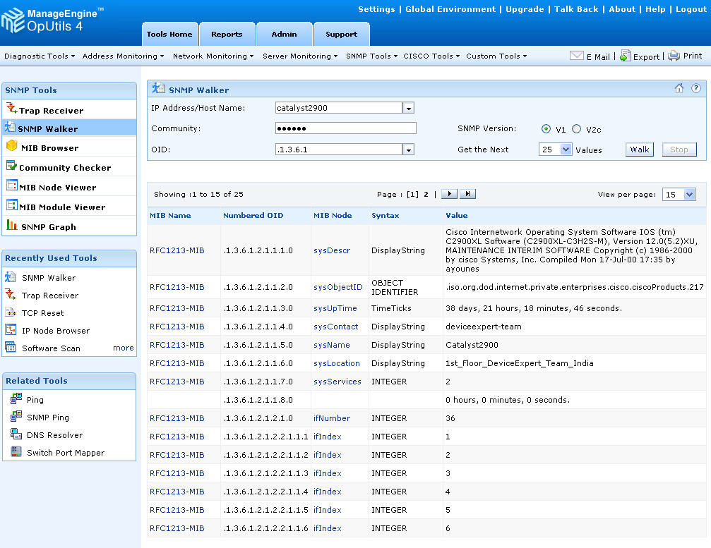

Slide 82
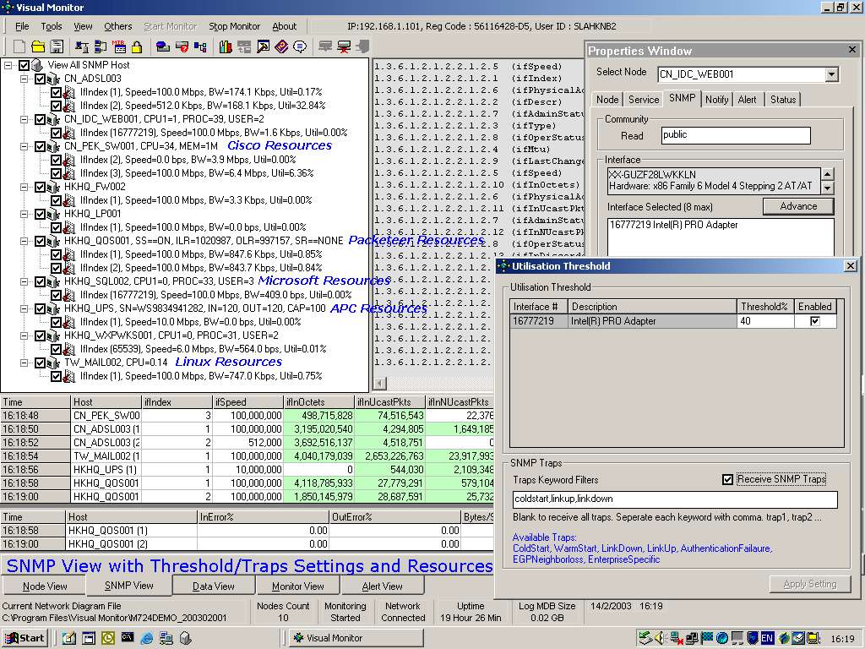

Slide 83
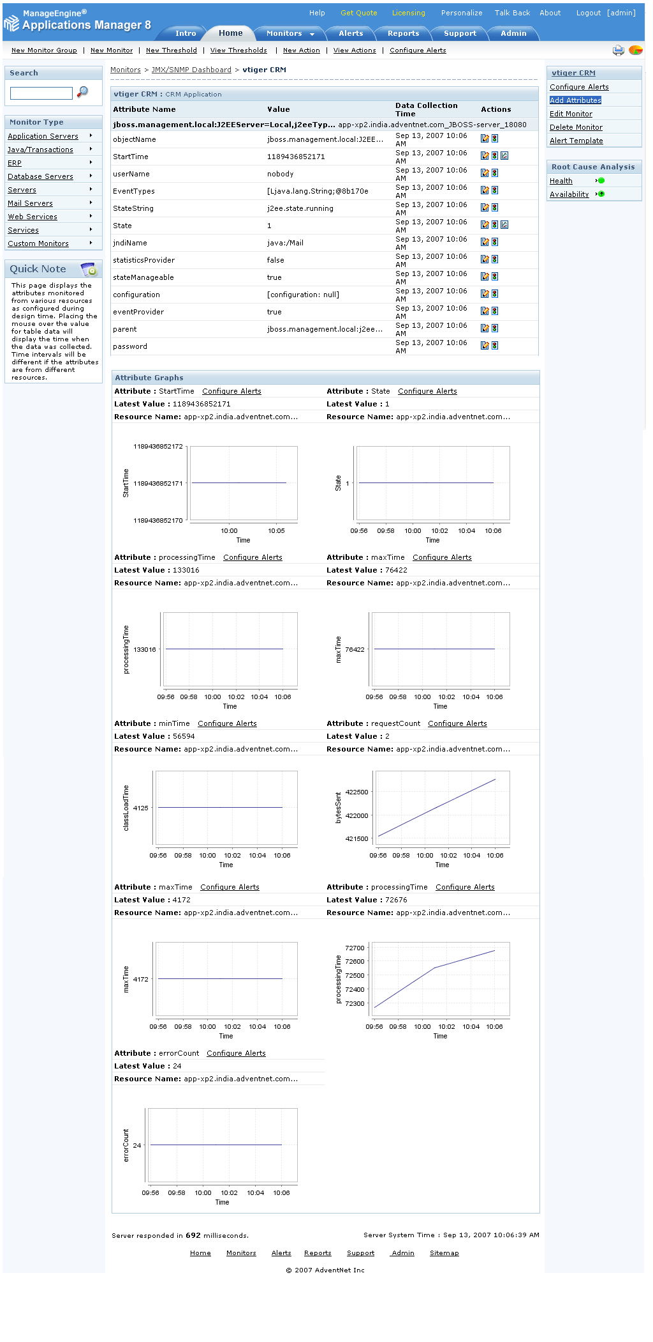

Slide 84
RFCs
Base
RFC 1155: Structure and Identification of Management Information for the TCP/IP-based Internets
RFC 1156: Management Information Base for Network Management of TCP/IP-based internets
RFC 1157: A Simple Network Management Protocol (SNMP)
RFC 1441: Introduction to version 2 of the Internet-standard Network Management Framework
RFC 1213: Management Information Base for Network Management of TCP/IP-based internets: MIB-II
RFC 3410 (Informational): Introduction and Applicability Statements for Internet Standard Management Framework
Standard 62
RFC 3411: An Architecture for Describing Simple Network Management Protocol (SNMP) Management Frameworks
RFC 3412: Message Processing and Dispatching for the Simple Network Management Protocol (SNMP)
RFC 3413: Simple Network Management Protocol (SNMP) Application
RFC 3414: User-based Security Model (USM) for version 3 of the Simple Network Management Protocol (SNMPv3)
RFC 3415: View-based Access Control Model (VACM) for the Simple Network Management Protocol (SNMP)
RFC 3416: Version 2 of the Protocol Operations for the Simple Network Management Protocol (SNMP)
RFC 3417: Transport Mappings for the Simple Network Management Protocol (SNMP)
RFC 3418: Management Information Base (MIB) for the Simple Network Management Protocol (SNMP)
Best Current Practice
RFC 3584: Coexistence between Version 1, Version 2, and Version 3 of the Internet-standard Network Management Framework
Proposed
RFC 3826: The Advanced Encryption Standard (AES) Cipher Algorithm in the SNMP User-based Security Model

Slide 85
Implementations
Net-SNMP (Net-SNMP: Open source SNMP implementation)
Netsnmpj: Open source SNMP for Java
OpenSNMP: multi-threaded SNMPv3 engine
PySNMP: pure-Python module, BSD license
TinySNMP: an easy to configure minimal SNMPv1 agent
.SNMPv3 for .NET
iReasoning MIB Browser / SNMP Manager (Free)
Net::SNMP : a pure Perl module that implements SNMPv1, v2 and v3 on IPv4 and IPv6
SNMP4J - Free SNMP API for Java Managers and Agents
versatile-serializing.net, .NET library, contains a SNMP V2C implementation

Slide 86
Post-Quiz: SNMP can
Monitor devices
Change devices
Warn of errors
All of the above
None of the above

Slide 87
Summary
SNMP is a protocol to define a framework for network management tasks
By itself is just a definition
Must be “made real” by products

