Slide 1
(Distributed) FILE SYSTEMS
Tony TonyTony K

Slide 2
Distributed File Systems
Desired Characteristics:
Universal Paths
Path to a resource is always the same
No matter where you are
Transparent to clients
View is one file system
Physical location of data is abstracted
E.g. it still looks and acts like local

Slide 3
Distributed File Systems – Examples
Microsoft DFS
Suite of technologies
Uses SMB as underlying protocol
Network File Systems (NFS)
Unix/Linux
Andrew File System (AFS)
Developed at Carnegie Mellon
Used at: NASA, JPL, CERN, Morgan Stanley

Slide 4
Distributed File Systems
Allows a server to act as persistent storage
For one or more clients
Over a network
Usually presented in the same manner as a local disk
First developed in the 1970s
Example: Network File System (NFS)
Created in 1985 by Sun Microsystems
First widely deployed networked file system

Slide 5
Distributed File Systems
Ability to relocate volumes while online
Replication of volumes
Most support read-only replicates
Some support read-write replicates
Allows load-balancing between servers
Partial access in failure situations
Only volumes on a failed server unavailable
Some support for turning a read-write replicate into a read-write master
Often support file caching
Some support offline access

Slide 6
Network File System
NFS

Slide 7
NFS – A Brief History
NFSv1
ca. 1985
Sun Internal release only
NFSv2
RFC 1094, 1989
UDP only
Completely Stateless
Locking, quotas, etc. outside protocol
Handled by extra RPC daemons

Slide 8
NFS – A Brief History
NFSv3
RFC 1813, 1995
64-bit file sizes and offsets
Asynchronous writes
File attributes included with other responses
TCP support

Slide 9
NFS – A Brief History
NFSv4
RFC 3010, 2000
RFC 3530, 2003
Protocol development handed to IETF
Performance improvements
Mandated security (Kerberos)
Stateful protocol

Slide 10
NFS – Extensions
Network Lock Manager
Supports Unix System V style file locking APIs
Remote Quota Reporting
Allows users to view their storage quotas

Slide 11
NFS – Quirks
Mapping users for access control not provided by NFS
Central user management recommended
Network Information Service (NIS)
Previously called Yellow Pages
Designed by Sun Microsystems
Created in conjunction with NFS
LDAP + Kerberos is a modern alternative

Slide 12
NFS – Quirks
Design requires trusted clients (other computers)
Read/write access traditionally given to IP addresses
Up to the client to:
Honor permissions
Enforce access control
RPC and the port mapper are notoriously hard to secure
Designed to execute function on the remote server
Hard to firewall
An RPC is registered with the port mapper and assigned a random port

Slide 13
NFS – Quirks
NFSv4 solves most of the quirks
Kerberos can be used to validate identity
Validated identity prevents rogue clients from reading or writing data
RPC is still annoying

Slide 14
Andrew File System
AFS

Slide 15
AFS – History
1983
Andrew Project began at Carnegie Mellon
1988
AFSv3
Installations of AFS outside Carnegie Mellon
1989
Transarc founded to commercialize AFS
1998
Transarc purchased by IBM
2000
IBM releases code as OpenAFS

Slide 16
AFS – Benefits
AFS has many benefits over traditional networked file systems
Much better security
Uses Kerberos authentication
Authorization handled with ACLs
ACLs are granted to Kerberos identities
No ticket, no data
Clients do not have to be trusted

Slide 17
AFS – Benefits
Scalability
High client to server ratio
100:1 typical, 200:1 seen in production
Enterprise sites routinely have > 50,000 users
Caches data on client
Limited load balancing via read-only replicates
Limited fault tolerance
Clients have limited access if a file server fails

Slide 18
AFS – Caching
Read and write operations occur in file cache
Only changes to file are sent to server on close
Cache consistency occurs via a callback
Client tells server it has cached a copy
Server will notify client if a cached file is modified
Callback must be re-negotiated if a time-out or error occurred
Does not require re-downloading the file

Slide 19
AFS – Volumes
Volumes are the basic unit of AFS file space
A volume contains
Files
Directories
Mount points for other volumes
Top volume is root.afs
Mounted to /afs on clients
Alternate is dynamic root
Dynamic root populates /afs with all known cells

Slide 20
AFS – Volumes
Volumes can be mounted in multiple locations
Quotas can be assigned to volumes
Volumes can be moved between servers
Volumes can be moved even if they are in use

Slide 21
AFS – Read-Only Replicates
Volumes can be replicated to read-only clones
Read-only clones can be placed on multiple servers
Clients will choose a clone to access
If a copy becomes unavailable, client will use a different copy
Result is simple load balancing

Slide 22
AFS – Limitations
Whole-file locking
Prevents shared databases
Deliberate design decision
Directory-based ACLs
Can not assign an ACL to an individual file
Complicated to setup and administer
No commercial backer
Several consulting companies sell support

Slide 23
Cluster File Systems

Slide 24
Cluster File Systems
Allow multiple clients to read/write files at same time
Designed for speed and/or redundancy
Often provide share-access to the underlying file system (block-level)
Clients can communicate with each other
Lock negotiation
Transferring of blocks
Many provide fault tolerance

Slide 25
Cluster File Systems – Examples
Lustre
Cluster File Systems, Inc.
General Parallel File System (GPFS)
IBM
Global File System (GFS)
RedHat

Slide 26
Poll: NAS and SAN
Same tech, different marketing names
Both serve files
Both serve data
One is better than the other
Both are obsolete

Slide 27
NAS or SAN?
SAN is not NAS backwards!

Slide 28
DAS, NAS or SAN?

Slide 29
NAS

Slide 30
Networked Attached Storage
Server that serves files to network attached systems
CIFS (SMB) and NFS are two example protocols a NAS may use
Often used to refer to ‘turn-key’ solutions
Crude analogy: formatted hard drive
Accessed through network

Slide 31
SAN

Slide 32
Storage Area Network
Designed to consolidate storage space into one cohesive unit
Note: can also spread data!
Pooling storage allows better fault tolerance
RAID across disks and arrays
Multiple paths between SAN and servers
Secondary servers can take over for failed servers
Analogy: unformatted hard drive

Slide 33
SANs
SANs normally use block-level protocols
Exposed to the OS as a block device
Same as a physical disk
→ can boot off of a SAN device
Only one server can read/write a target block
Contrast to NAS access
Multiple servers can still be allocated to a SAN
SANs should never be directly connected to another network
Especially not the Internet!
SANs typically have their own network
SAN protocols are designed for speed, not security

Slide 34
Network: SAN vs. LAN
XXXXXXXXXXXXXXXXXXXX
LAN – Usually the same as the Client LAN

Slide 35
SANs - Protocols
Fibre Channel
Combination interconnect and protocol
Bootable
iSCSI
Internet Small Computer System Interface
Runs over TCP/IP
Bootable
AoE (ATA over Ethernet)
No overhead from TCP/IP
Not routable
Not a bad thing!

Slide 36
SANs – Common Workloads
File Servers
Database Servers
Virtual machine images
Physical machine images

Slide 37
Simple SAN

Slide 38
Simple SAN - Failover

Slide 39
Simple SAN - Reallocation

Slide 40
RAID
SIDEBAR

Slide 41
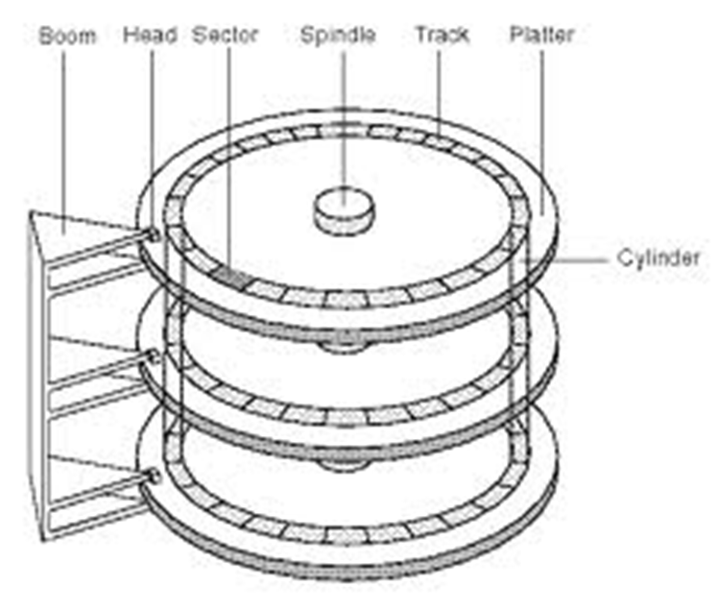
First: How does a hard drive work?

Slide 42
Hard Drive
The disk hardware:
Writes data to a specific location on the drive
On a selected platter
On a specified track
Rewriting a complete specific sector
1’s and 0’s
Disks know nothing of files

Slide 43
Hard Drive
The OS:
Keeps track of file names
File system
Maps file names
To where on the disk the 1’s and 0’s are kept for the data
File may be broken up (fragmented)
To fit available space chunks on disk
Specific part of the disk is reserved for this mapping
FAT, VFAT, FAT32, HPFS, NTFS, EXT2, EXT3, etc…
Note: the OS usually has a copy of this mapping in memory

Slide 44
RAID
Redundant Array of Independent (Inexpensive) Disks
2 or more drives
→ 1 drive
Various levels – RAID 0,1,2,3,4,5,6
Only 0, 1, 5 and 6 are in common use now
10, 50, 60 – unofficial levels
RAID function can be done via hardware or software

Slide 45
RAID Sidebar: Common Levels
RAID 0: Striped
2 or more drives configured as one
Data is striped across multiple drives
Pluses:
“Larger” capacity
Speed
Can access/write data across multiple drives simultaneously
Minuses:
Higher Failure rate than single drive
Total data loss if one drive fails

Slide 46
RAID Sidebar: Common Levels
RAID 1: Mirrored
2 or more drives configured as one
Usually 2 drives
Data copied (duplicated) on both drives
Pluses:
Lower “failure” rate
No data loss if one drive fails
Minuses:
“Wasted” drive space
e.g. 50% for a 2 drive system
Small performance impact

Slide 47
RAID Sidebar: Common Levels
RAID 5: Parity
3 or more drives configured as one
Data spread across multiple drives with parity
If one drive fails, data can be rebuilt
Pluses:
“Larger” drive
Can survive one drive failure
Minuses:
More complex
Some “wasted” drive space

Slide 48
RAID Sidebar: Common Levels
RAID 6: Enhanced RAID 5
4 or more drives configured as one
Additional parity block
Pluses:
Improved data safety
Can survive 2 drive failures
Minuses:
More “wasted” space
Write penalty

Slide 49
RAID Sidebar: Uncommon Levels
Combinations of 0 and 1
RAID 01
Mirror of stripes
RAID 10:
Stripe of mirrors
4 or more drives configured as one
Pluses:
Speed
Data safety
Minuses:
“Wasted” capacity

Slide 50
RAID Sidebar: Uncommon Levels
No common definition
RAID 50: Combination of 5 and 0
Sometimes referred to as 5+0
RAID 60: Combination of 6 and 0
Sometimes referred to as 6+0

Slide 51
How many drive failures can Raid 6 Survive:
0
1
2
3
4

Slide 52
Last Note:
SAN can be “RAIDed”
SAN blocks spread across the network

