Slide 1
ITIS 3110 IT Infrastructure II
Syslog

Slide 2
Logging

Slide 3
Logging
Best practice is to centralize all logs on a network
To a dedicated log host
Good for debugging, forensics, etc.
Centralized logging needs a shared clock for best results
i.e. did events on two separate machines really occur at the same time

Slide 4
Syslog
Port 514/UDP
Modern implementations support TCP as well
Most computers and devices can generate syslog messages
UDP is used because it is stateless
.e.g it is fast…

Slide 5
Syslog Facilities
Every syslog message is associated with a facility
The facility is the general source of the message
Example facilities are
AUTH
CRON
DAEMON
FTP
MAIL
Allows different facilities to be handled differently
Each facility has its own level

Slide 6
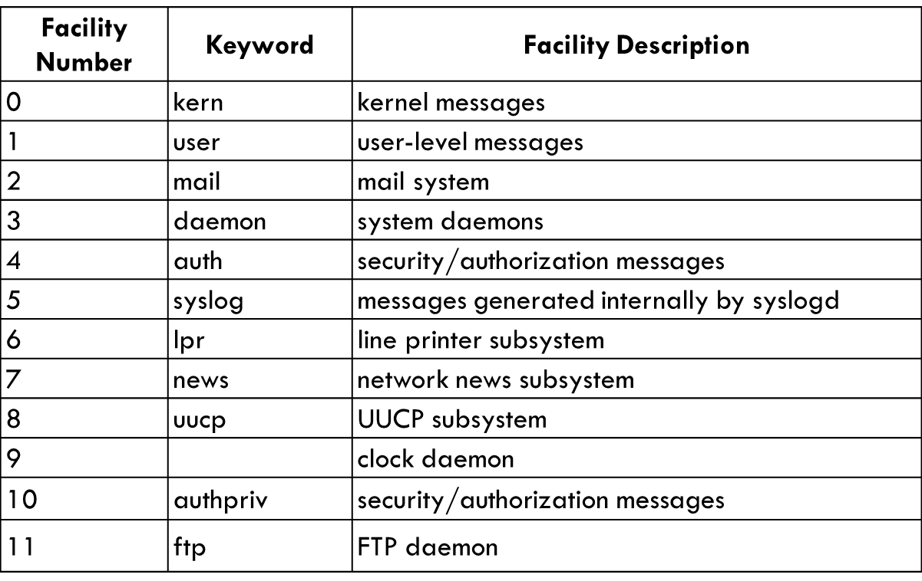
Facility Levels 0-11

Slide 7
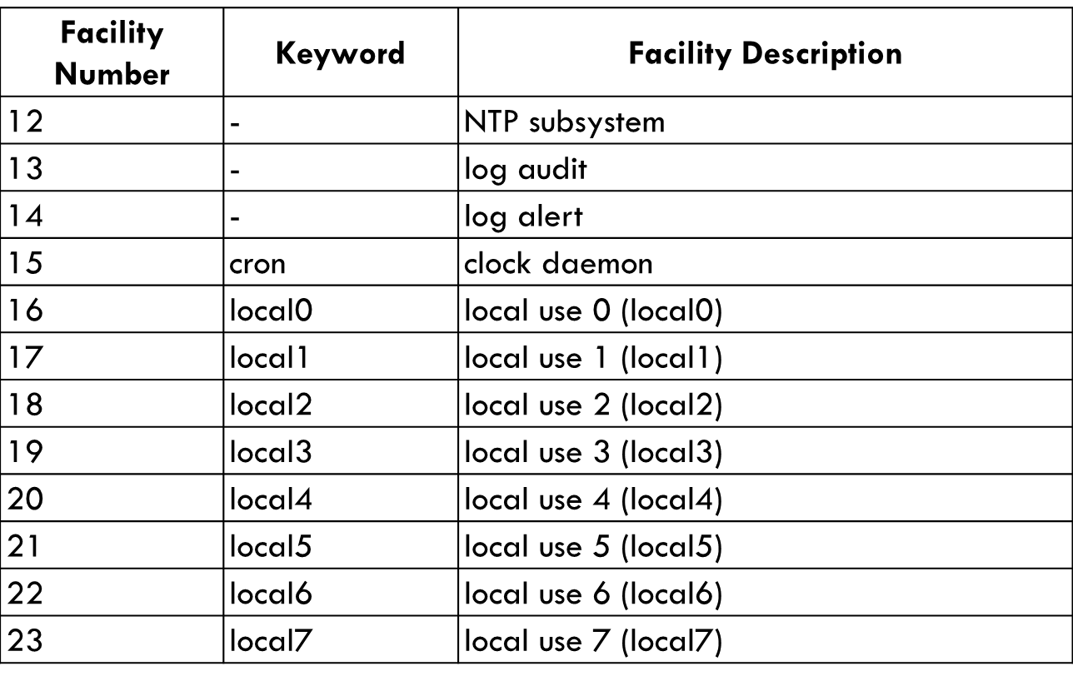
Facility Levels (12-23)

Slide 8
Syslog Priorities
Every syslog message has a set priority
Declares how important the message is
Examples are:
debug
notice
warning
error

Slide 9
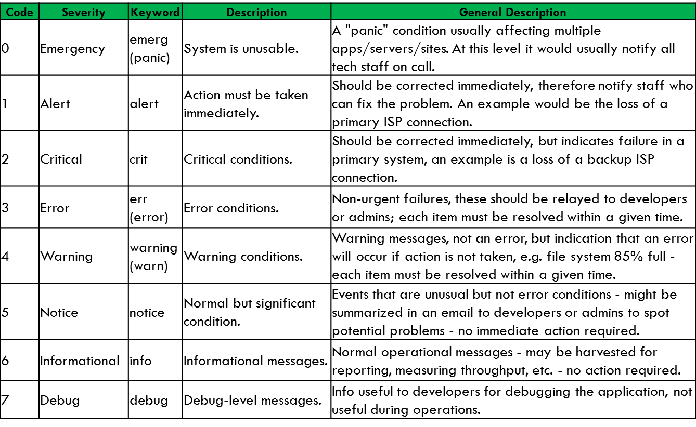
Severity Levels
A common mnemonic used to remember the syslog levels down to top is:
"Do I Notice When Evenings Come Around Early".

Slide 10
Syslog Configuration
Messages can be routed based on facility and priority
What subsystem and its importance
Destination can be:
Local log file
Remote syslog server
Log files can be written synchronously or asynchronously
Synchronous – slower but guaranteed write
Asynchronous – faster, but may lose some logs if the system crashes

Slide 11
Example Syslog Configuration

Slide 12
Notes about the configuration
*
The asterisk is a ‘glob’ character.
It means to match anything
You will see it in many configuration files as well as on the command line
/dev/console
UNIX has a philosophy that everything is a file
/dev/console is a device file
It writes messages to all locally attached terminals

Slide 13
Syslog: Security Considerations
No authentication
No encryption
UDP source can be spoofed
Malicious user could run log server out of disk space
Same for a misconfigured system

Slide 14
Syslog: Security Mitigations
Limit access to Syslog with a firewall
Run on internal network if possible
Log to a separate partition
Monitor disk usage on log server
Use more feature-rich syslog implementations that support TCP and/or encryption

Slide 15
Why do NTP and Syslog need to work together:
Both share the same base protocol
All systems need a common time base for log timestamps
TCP requires synchronized packet transfers
It keeps the NSA synchronized
9
30 sec countdown

