Slide 1
ITIS 3110 System Auditing

Slide 2
overview
UNIX history
Installed software
System services
Open ports (network services)
Running processes
Account and permission management

Slide 3
system auditing
Some of this lecture may be familiar
Bits and pieces have come up during labs
Aim is to tie some of these things together

Slide 4
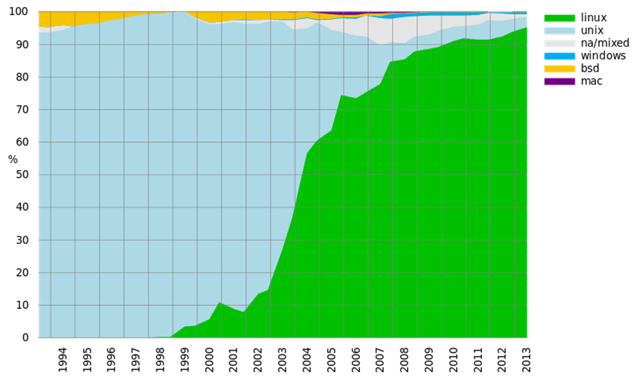
why unix?
http://en.wikipedia.org/wiki/Usage_share_of_operating_systems#Servers
UNIX/Linux/etc
MS Windows
Super computers
Same ref as above

Slide 5
why unix?
According to W3Techs (Aug 2011), 64% of all web servers are Unix based
Most of these are Linux
Does not include Unix derived infrastructure equipment
home based routers, Cisco IOS, etc
Does not include mobile platforms
Note: Android phones run a Linux kernel

Slide 6
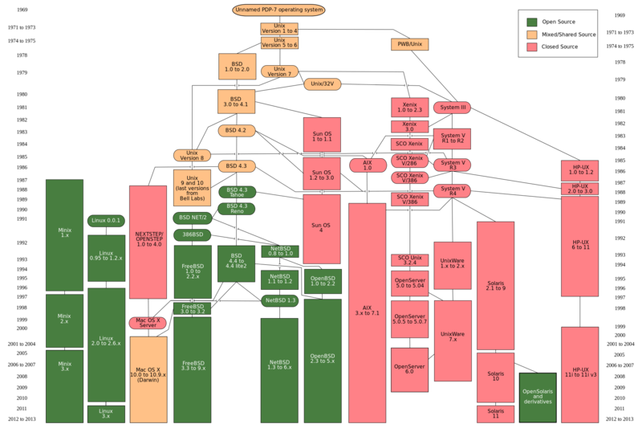
unix family

Slide 7
unix history
Two main branches to be concerned with
AT&T System V
Derived from UNIX developed at Bell Labs
BSD
Re-implementation from Berkley

Slide 8
System V vs. BSD
System V and BSD tend to do things differently
Due to schism in the 1970's
Linux inherits quirks from both families
Can be seen in system commands
ps -ef
(System V)
ps aux
(BSD)

Slide 9
linux family

Slide 10
Package Management

Slide 11
package management
Software on most Linux machines is delivered/installed as packages
A Package Manager is used to perform tasks related to packages

Slide 12
PM Capabilities
Searching
Downloading
Dependency detection and resolution
Conflict detection and resolution
Installation
Configuration
Upgrading
Removing
Verification
Determining ownership of files

Slide 13
Categories/Types
Package managers are usually split into two categories
Simple package managers
Front-ends

Slide 14
Types
Simple package managers have been around almost as long as Linux
Front-ends add functionality to a simple package manager
dependency resolution
network access
graphical user interface

Slide 15
rpm
rpm package manager
originally Red Hat Package Manager
Developed by Red Hat
Part of the Linux Standards Base
Used in:
CentOS
Novell Netware
IBM AIX
many others

Slide 16
dpkg
Developed for Debian Linux
Circa 1993
Function comparable to RPM
Used by many Linux distributions
Used by fink on OS X

Slide 17
rpm front-ends
yum is the de facto standard
Yellowdog Updater, Modified
Developed at Duke
up2date is used by Red Hat for paying customers
Others…

Slide 18
dpkg front-ends
Many, many front-ends available
Command line front-ends
apt-get
Terminal/text oriented
aptitude
Terminal/ncurses oriented
Graphical front-end
synaptic

Slide 19
look familiar?
You have used two package manager front-ends in your labs
apt tools
(Debian)
aptitude
(Debian)
yum
(CentOS)

Slide 20
package listings
yum updates package listings automatically
aptitude update

Slide 21
updating packages
yum update
aptitude safe-upgrade
aptitude dist-upgrade

Slide 22
Inspecting installed packages
Function | RPM | DPKG
installed | rpm -qa | dpkg -l
contents | rpm -ql package | dpkg -L package
owner | rpm -qf path | dpkg -S filename

Slide 23
Verifying files
Verifying:
Ensuring what was installed on a machine is still “intact”
rpm can verify files on disk using stored metadata
rpm -Va
rpm -V package
rpm -Vf path

Slide 24
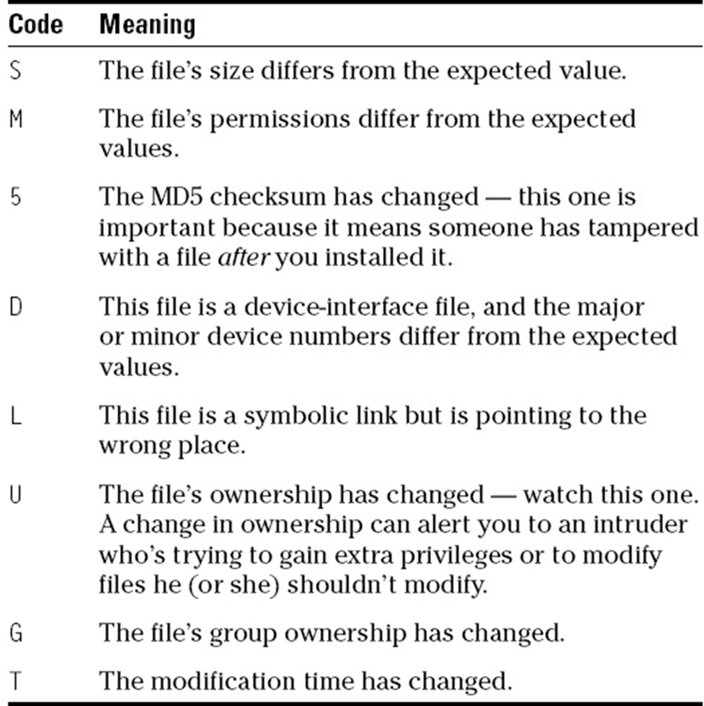
rpm verify

Slide 25
Windows Package Mgmt Systems
PMS systems are available for Windows
“Proprietary”
Win 10 includes OneGet
Some are cross-system
E.g. Windows/OS X/Linux

Slide 26
System startup/control

Slide 27
linux boot sequence
Linux kernel only calls one process: init
init handles loading processes and services
Majority of Linux systems use an init based on System V

Slide 28
System V init
based on concept of ‘run levels’
Configuration is in /etc/inittab
services started by each run level in /etc/rc?.d/
where ? is the run level

Slide 29
run levels
Run levels usually numbered 0-6
Others may exist (e.g. S)
Meaning of each run level usually described in /etc/inittab

Slide 30
standard run levels
0 – Halt the system
1 – Single user
2 – Multi-user (without NFS)
3 – Multi-user
4 – unused
5 – Multi-user, graphical mode
6 – reboot
Notes:
System may only be in one runlevel at a time
0 and 1 are usually used to debug
Various distros may interpret differently

Slide 31
debian run levels
2-5 are multi-user
S - system initialization

Slide 32
centos run levels
0 – halt
1 – single user
2 - multi-user without NFS (no networking)
3 - full multi-user
5 - X11
6 - reboot

Slide 33
default run level
Default run level was stored in /etc/inittab
id:3:initdefault:
Current and previous run level can be checked with runlevel
#sudo runlevel #N 3
Run level can be changed with telinit
Debian: function now in /etc/systemd/
systemctl is the tool

Slide 34
/etc/rc?.d/
Contains links to service scripts in /etc/init.d/
Starting and stopping services:
K##service
stops service in this run level
S##service
starts service in this run level
Where:
## is a number
Scripts are started or stopped in alphabetic order

Slide 35
/etc/init.d/
Contains scripts to start and stop services
Service scripts have minimum of three options:
start, stop, restart
Others options may be supported
status, reload
Notes:
varies by system
system command can control too
Tries to be the same between systems

Slide 36
Services
“background” programs

Slide 37
services
Most services are ‘daemons’
Daemons: programs running in background
No open terminal
Services are started and stopped from scripts in /etc/init.d/
Services include things like
networking
web servers
X11

Slide 38
services
Running services increases potential attack vectors
Unused services should be disabled
Removing is a better option if practical
Running services take up resources

Slide 39
disabling services
Services can be disabled by moving S##service in all /etc/rc?.d/ directories to K##service
Most distributions provide helper utilities
chkconfig
(CentOS)
update-rc.d
(Debian)

Slide 40
disabling services
CentOS
/etc/init.d/service stop
chkconfig service off
Debian
/etc/init.d/service stop
rm /etc/rc?.d/[SK]??service
update-rc.d service stop ## 0 1 2 3 4 5 6 S .

Slide 41
network services
Knowing what ports are open on a system is important to keeping it secure
Disabling unused services will limit the number of ports available to crackers

Slide 42
Auditing “Tools”

Slide 43
checking open ports
netstat is your friend when dealing with networking
display routing table:
netstat -r
display open ports:
netstat –atunp
See next page for explanations

Slide 44
netstat options
-a
show listening and non-listening sockets
-t
TCP
-u
UDP
-n
do not resolve host or port names
-p
show process names and IDs (root only)

Slide 45
Linux Firewall: iptables
iptables is the firewall in Linux
also for NAT
Many systems ship with it enabled by default
If you are having odd problems
check to see if it running
It usually is controlled from /etc/init.d/
Firewalls are recommended
but checking it is an important troubleshooting step

Slide 46
iptables

Slide 47
running processes
ps
is the quintessential tool to view the process list
ps aux
a u and x are separate options
can be in any order
view all processes on a system
ps auxww
No line formatting to pipe to another command
ps faux
view processes as a ‘forest’
children processes are shown below parent
Note: - is "not needed" for some options
indeed ps aux and ps -aux are different options
-a is different than a

Slide 48
ps popular options
f
show process hierarchy (forest)
a
show processes belonging to all users
u
display user-oriented format
x
include processes without a TTY
TTY == teletype == interactive process
w
wide output
twice (ww) is unlimited output

Slide 49
top
top
Interactive way to view the process list
From a CLI terminal
‘<‘ and ‘>’ changes sort column
1
toggles individual and combined CPU views
z
enables color output

Slide 50
lsof
lsof
Displays open files and internet sockets
Tons of options!

Slide 51
Scheduling tasks

Slide 52
cron and at
cron
daemon that runs jobs at set intervals
at
daemon that runs a job at a specified time
cron
jobs repeat
Does not run if machine is off
Use anacron
at
a job is only run once

Slide 53
cron
crontab -l
to view your cron jobs
/etc/cron.deny
contains users not permitted to use cron
one per line
Cron jobs can be stored in:
/var/spool/cron/$USER
/etc/crontab
/etc/cron.{d,hourly,daily,weekly,monthly}/

Slide 54
crontab format

Slide 55
anacron
Similar to cron
Does not require computer to be running continuously
Runs next time computer started
If the job was to run when the system was off
Options to specify how to run “missed” jobs

Slide 56
at
atq
view your pending jobs
/etc/at.deny
contains users not permitted to use at
one per line

Slide 57
Permissions
Files and Directories

Slide 58
permissions
All files belong to an owner and a group
Three sets of permissions:
owner
group
world
Three permissions available:
read
write
execute
Execute on a directory allows a user to cd into it

Slide 59
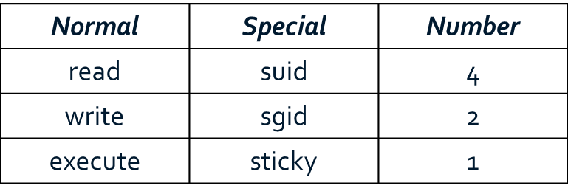
special permissions
Three special permissions:
suid
S or s
Program executed with file owners permissions
sgid
S or s
Program executed with groups permissions
s
sticky
T or t
Program:
Programs stay in memory after execution (usual def)
Directory
Users can create files, but only owner can delete
UNIX permissions can be specified in octal
rwx = 4+2+1 = 7
Special Permissions can be set with a 4th octal, e.g. 1777, 4775, etc.
Note:
S or T – SxID set, normal r, w, or x not set
s or t – SxID set, normal r, w or x is also set

Slide 60
permissions
-rwsr-xr-x 1 root root 37312 Sep 26 2009 /bin/ping
drwxrwxrwt 6 root root 12288 Oct 20 18:46 /tmp

Slide 61
Resume 2/13

Slide 62
Account Management

Slide 63
account management
Briefly covered name services before
Again, getent is your friend
For an external account management like LDAP or Kerberos
root should be only account with local password

Slide 64
account management
w
tells you people currently logged in and from where
more details than who
last
gives you login history for all users

Slide 65
Misc.

Slide 66
finding files
apropos
Allows searching of man pages
Very important!
locate
Database is index of files on system
Database created/updated by updatedb
Often out of date, if database is built at all
Could use cron to schedule
find
Lets you find files
Slow but powerful

Slide 67
find
Syntax:
find [-H] [-L] [-P] [-D debugopts] [-Olevel] [starting-point] [expression]
Last 2 options usually used
Starting Point
First directory
Expression
What to look for

Slide 68
find examples
find / -xdev -name \*.java -print 2>/dev/null
find . -name core -print0 | xargs -0 rm
find / -xdev -perm /600 -print
find / \( -nouser -o -nogroup \) –print
Options described on next page

Slide 69
find options
-xdev
stop at filesystem boundaries
-name
match filenames matching pattern
-print
output results
-print0
output results separated by a ‘\0’
use if the file name may contain a newline character
-perm
matches file permissions

Slide 70
/sys and /proc
Linux exposes much of its internals via
/proc
/sys
/proc
contains information about all running processes
by process ID
/sys
info on the system and its components
Original intent was to make debugging easier
Many options can be tweaked via /proc or /sys
Note:
/sys and /proc are not “real”
pseudo-files
most are read-only

Slide 71
data hiding
Different forms of data hiding have been used by hackers to cover their tracks
Hidden files and directories
e.g. ‘. ‘, ‘...’ ‘.^G.’
mangling argv[0]
Replacing system utilities with hacked copies

Slide 72
baselines
Commands covered allows one to gather a large amount of information about a system
Being familiar with these commands is important for administers
If something goes wrong
Need a frame of reference to see if anything is out of the ordinary
→ create and keep a copies/records of configurations to compare to current data

