Slide 1
Programming the Web using XHTML and JavaScript
Chapter 1
Introduction to the Internet

Slide 2
Origins of the Internet
1960 – Computer communication difficult
Different operating systems & procedures
Transferring data was clumsy and inefficient
Hub concept
CPU

Slide 4
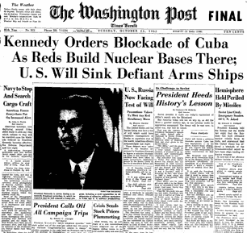

Slide 5
C3
Military term
Command
Control
Communications
1960’s
Military started relying on computer communications
ARPA (DARPA)
(Defense) Advanced Research Projects Agency

Slide 6
Centralized
Two big problems
Central hub congestion as the network grows
Easily disabled by nuclear attack

Slide 7
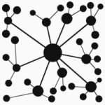
Decentralized
Better but still problems
Allows for better scaling as network grows
Strategically removing nodes will isolate groups

Slide 8
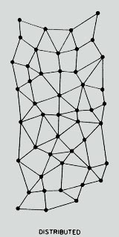
Distributed
Most robust
Single or multi node failures
Can route around congestion
More complex in routing

Slide 9
Origins of the Internet
Paul Baran’s distributed concept
No central hub
Network would automatically adjust around disabled computers
Advanced Research Projects Agency
ARPANET
1st 4 sites:
UCLA, UC Santa Barbara, U. Utah, Stanford

Slide 10
Origins of the Internet
Started as ARPANET
DoD funded
Evolved into the Internet
Academic World
Commercial/Public World
1980’s – 1,000 computers connected
A “network of networks” is an Internetwork
“Internet” for short

Slide 11
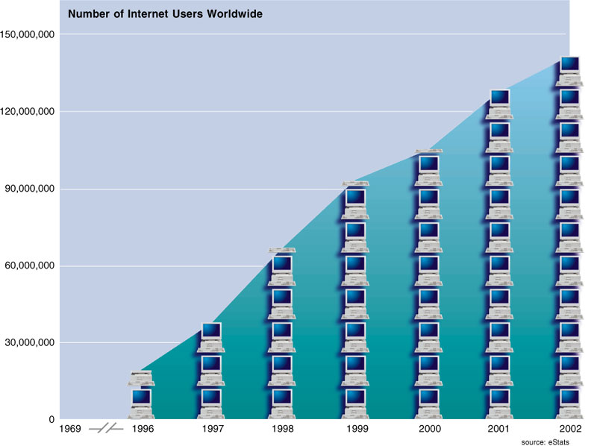

Slide 12
Latest stat:
2005 - 1 billion users
2008 data (number of computers):
http://www.c-i-a.com/pr0109.htm
Latest (number of internet users):
http://www.internetworldstats.com/stats.htm

Slide 13
Packets and Routers
No hub = no central authority
How can such a network operate?
Routers
Specialized computers (HW & SW)
Manage communications
Packets
The content managed by routers

Slide 14
Packets and Routers
Packet
100-1,500 bytes of data
Header
Filename
Origin and destination
Order number (1 of 50, 2 of 50, 3 of 50, …)
Packet-switching

Slide 15
TCP/IP and Domain Names
1983 standardized TCP/IP
Two Distinct Protocols!
IP = Internet Protocol
How to get data from one machine to another
Uses routers
TCP = Transmission Control Protocol
Breaks original message into packets
Reassembles packets at destination
Performs error-checking
Requests re-transmission as necessary

Slide 16
TCP/IP and Domain Names
IP address
Uniquely identifies every computer
“Dotted quad” = 16.42.125.78
Total of 32 bits
Each quad is an octet (8 bits or 1 byte)
0 – 255 decimal
Over 4 billion addresses
IPv6
64 billion billion billion addresses

Slide 17
Specific computer
Varies by Class
Class Type (A, B, C)
?
Notes:
INTERNET ADDRESSES
IP (Internet Protocol) address has four parts 
255 x 255 x 255 x 255 = 4,228,250,625
IP address hard to remember and use
Text version called a domain name has 3 parts.

Slide 18
Two Level Internet Address Structure
Network Number + Host Number
or
Network Prefix + Host Number
Notes:
http://www.3com.com/other/pdfs/infra/corpinfo/en_US/501302.pdf

Slide 19
Address Classes
Three common
Class A
Class B
Class C
Two “unusual”
Class D
Class E
32 bits used for addresses

Slide 20
IP Class Identification
Class A
0
1
7
8
31
0
Class B
0
2
15
16
31
10
Class C
0
3
23
24
31
110

Slide 21
Class A
Left most octet
First bit 0
Values 1-126
126 networks
Note: values 0 and 127 have special meaning
Large computer networks
Supports approx. 16 million hosts

Slide 22
Class B
Uses 2 left octets
First 2 bits 10
Left most octet 128 – 191
Second octet any value 0-255
16,384 networks
Medium Networks
65,536 hosts

Slide 23
Class C
Left 3 octets
First 3 bits 110
Leftmost 192-223
Other two in range 0-255
2,097,152 networks
Small networks
255 hosts

Slide 24
Special Classes
Class D
First four bits 1110
Multi-casts
Class E
First four bits 1111
Expermental

Slide 25
IP Summary
IPv4: Although there are over 4 billion addresses available they are inefficiently assigned
IPv6 vastly expands the addresses
3.4x10³⁸

Slide 26
Sidebar: How big is 3.4 x 10³⁸?
Course sand: ~1mm (10⁻³ meter)
1 cubic meter of sand has:
1000 x 1000 x 1000 grains
10⁹ grains (1 billion!)
1 cubic kilometer has:
(10⁹)³ or 10²⁷ grains!
So 3.4 x 10³⁸ grain would fill
3.4 x 10¹¹ cubic kilometers!
Volume of the Earth:
1.0832×10²¹ m³ or about 1x10¹² km³
Fill about 1/3 Earth!

Slide 27
Sidebar: How big is 3.4 x 10³⁸?
Another view
About 100 billion stars in a galaxy (10¹¹)
About 100 billion galaxies
→ 10²² stars in the universe!
Enough address for the all the stars in 10¹⁶ universes
10,000,000,000,000,000 -or-
10 quadrillion!

Slide 28
Sidebar: How big is 3.4 x 10³⁸?
And now the bad news:
Approximations vary, but best guess are there are about 1 x 10⁷⁹ atoms in the universe
IPv6 can’t give each atom it’s own unique IP address ☹

Slide 29
TCP/IP and Domain Names
Numeric addresses like 166.082.001.003
Who is it for?
Difficult to remember
Names like www.yahoo.com or uncc.edu
Easier to remember
Has human meaning

Slide 30
TCP/IP and Domain Names
DNS – Domain Name System
host.organization.domain
Top-level domain
Controlled by ICANN
Internet Corporation for Assigned Names and Numbers
Strict name conventions
By country (us, uk, ca, …)
By organization Type (com, org, edu, ..)
Organization (Microsoft, Yahoo, Google)
Assigned by ICANN sanctions companies
Can be “anything” not previously assigned
Host (www, ftp, webpages, …)
Assigned by the organization
Can be anything but www is the most common

Slide 31
Host
Organization
TLD: Organization type
Notes:
INTERNET ADDRESSES
IP (Internet Protocol) address has four parts 
255 x 255 x 255 x 255 = 4,228,250,625
IP address hard to remember and use
Text version called a domain name has 3 parts.

Slide 32
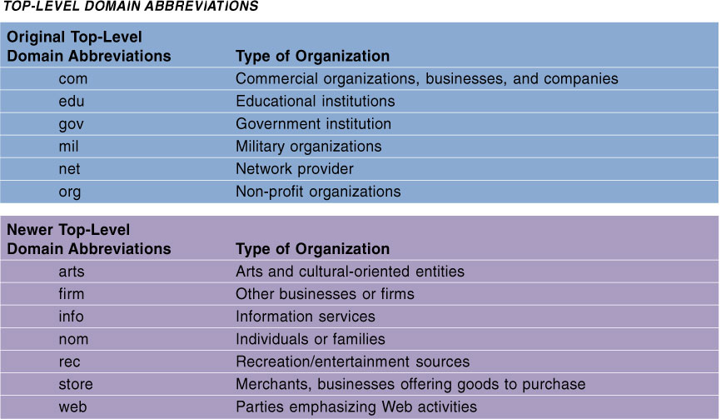
Notes:
For international sites, a country code is included ...

Slide 33
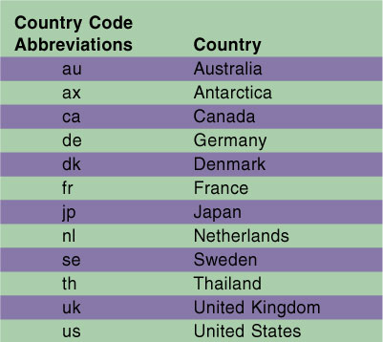

Slide 34
TCP/IP and Domain Names
ICANN – Internet Corporation for Assigned Names and Numbers
Oversees assignment of names and IP addresses
Domain Name Registrars
DNS servers

Slide 35
Early Basic Services
FTP – File Transfer Protocol
Moves files from computer to computer
TELNET
Connect to remote computer as if a local user
“Text” only – e.g. a text terminal
Early 70’s Ray Tomlinson
Hacked FTP to pass messages to users
E-Mail was born

Slide 37
Basic Services
Timothy Berners-Lee
1989
Trying to share documents between research groups at CERN
Hypertext
Markup language – formatting
Transfer protocol – send/receive marked-up document

Slide 38
Basic Services
HTML – Hypertext Markup Language
HTTP – Hypertext Transfer Protocol
Browser
W W W – World Wide Web

Slide 39
Basic Services
First browsers were text-based
1993 @ U. Illinois, MOSAIC created
GUI Browser – Graphical User Interface
Mosaic ⇨ Netscape

Slide 40
URL
Uniform Resource Locator
Where is the document
What type is the document
Method or protocol to retrieve and display the document
Two parts:
Protocol
http://
file://
ftp://
Host/domain name
www.uncc.edu
www.ibm.com

Slide 41
Client-Server Computing
Client
Server
Request
Client
Server
Response

Slide 42
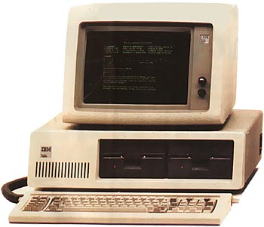
1981
Intel 8088
4.77 MHz
16 - 64 KB RAM
160KB floppy drives (1 or 2)
$4,000
IBM PC Model 5150

Slide 43
PC Comparison
 | 1981 | 2003 | % Change | 2007 Update | 2010 Update | 2010 Netbooks
Speed | 4.77 MHz | 2GHz | +41,929% | 2-4GHz | 2-3GHz (4-6 Cores) | 1.6GHz Atom
RAM | 16-64KB | 128MB | +800,000% | 512MB-8GB | 3-16GB | 1GB
Storage | 160KB | 40GB | +25,000% | 80GB-1TB | 500GB-2TB | 160-320GB
Cost | $4,000 | $690 | - 580% | $350-$8000 | $250 on up | $300 up
Notes on processor speeds:
The original 8088 took 8-15 cycles to compete one instruction.
Current processors can complete up to 8 instructions per cycle
Quad cores (4 processors per “CPU”) are now common with six core coming online in 2010

Slide 44
Assignment
See Assignments web page for details

