Slide 1
Web Development A Visual-Spatial Approach
Chapter 5
Site Structure

Slide 2
Learning Objectives
The process of developing a site structure
Identifying and labeling major content areas
Typical site structures
Techniques for communicating the site structure to users
Methods of user-testing and editing site structures

Slide 3
Developing Site Structures
Site structure development process involves organizing individual Web pages into a whole structure
Involves establishing relationships between pages and sections of a site
Process of developing a site structure involves
Analysis
Labeling
Design
Testing
Revising

Slide 4
Structure Analysis
Methods of analysis used to determine major content areas in the site structure are:
content analysis
visual-spatial analysis

Slide 5
Structure Analysis
A visual-spatial analysis is important for two reasons:
Measures how well the site structure and related features help users comprehend the organization and layout of the site
Helps identify how a more effective structure can be designed to fit user perception and need

Slide 6
Structure Analysis
Two visual-spatial concepts should be considered in structure analysis
Contextual
Wholeness

Slide 7
Structure Development
It is important to select meaningful labels that outline major content areas for users
Four types of labeling schemes are commonly used
Functional
Suggest a specific use
Metaphorical
Suggest an analogy
Topical
Organization by subject
User-defined
Unique to this site’s needs

Slide 8
Structure Development
Four types of Web structures serve as models for developing sites
linear
hierarchical
hypertextual
customized

Slide 9
Linear
Content flows one to another

Slide 10
Hierarchical
Structured order

Slide 11
Hypertextual
Anywhere to anywhere
As appropriate

Slide 12
Custom
Whatever is needed
Combination of
Linear
Hierarchical
Hypertextual
As needed

Slide 13
Structure Development
Site structures have visual-spatial characteristics two of which include:
Breadth
Number content pathways
What is the breadth of a Linear site?
What is the breadth of a Hierarchical site?
What is the breadth of a Hypertextual site?
Depth
Number of pages deep in a site structure
What is the depth of a Linear site?
What is the depth of a Hierarchical site?
What is the depth of a Hypertextual site?

Slide 14
Structure Development
One method of communicating the site structure to users is through the use of contextual cues
Outline content for users and help them discern the site structure
Signals to users:
Where they are in the structure
Where they have been
Where they can go

Slide 15
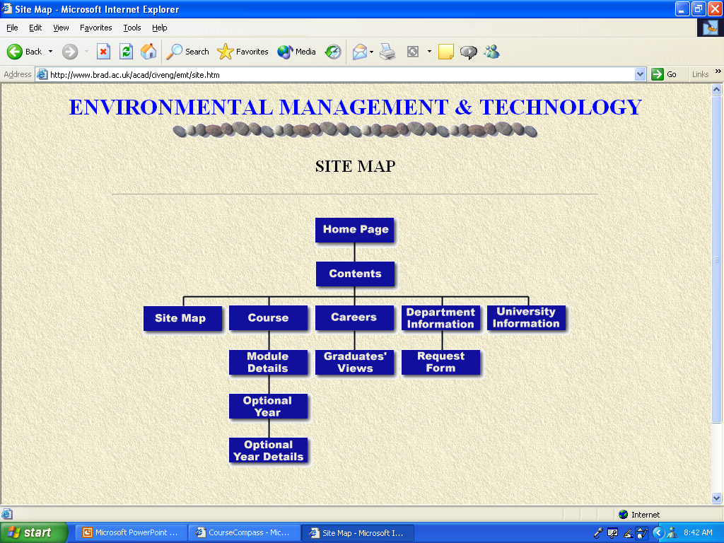
Developing a Site Structure: MAPS

Slide 16
Analysis and Identifying Content Areas
Figure out similar content areas
Match navigation to content organization

Slide 17
Selecting Meaningful Labels
Gives the user
Hint of the function provided
Hint of site organization

Slide 18
Defining Site Structures
Hierarchical
Sequential
Random
Combination
Customized to current needs

Slide 19
Testing and Revising
Two effective methods of testing site structures are card sorts and mock-up tests
Card sorts test how the site structure fits users’ perceptions of how information would be organized in the site
Mock-up tests involve creating a skeleton of the site with sample pages that follow the actual blueprint of the site structure
Revising the site structure involves both editing and condensing the arrangement of pages in the structure

Slide 20
Revising the Site Structure
Review the testing results
Was the site easily navigable?
Were paths to get to data too:
Complex?
Deep?
Obscure?

Slide 21
Summary
Building an efficient Web presence
Complex task
Need organization
Effort to create the Web site
Pages themselves
Needs to be maintained

Slide 22
Assignment
None

