Slide 1
The Web Wizard’s Guide to Web Design
Chapter 2
Designing Display and Navigation

Slide 2
Introduction
“A well-designed Web site doesn’t just look good; it also works well.” - WWG

Slide 3
Introduction
Remember: form follows function
Base site design on what users need to do
Functionality common to most Web sites:
Display of information
Navigation through the site
Choosing & finding
Feedback & interaction
Communicating the organization’s identity

Slide 4
The Display of Information
To decide which display works best, consider the user
How does the target audience think?

Slide 5
The Display of Information
Classical printed display styles
Magazine: 2-3 columns, images interspersed
Newspaper: 6-7 columns
Book: 1 column, images at top/bottom
Early Web design looked like existing printed pages
Problem: screens aren’t pages
Most printed format is portrait mode
Most monitors are landscape mode

Slide 6
The Display of Information
Printed pages | Screens
Up to 16” wide | 10” wide
High resolution: Magazine: 200 dpi Newspaper: 300 dpi 9 point type easy to read | Low resolution: 75 dpi* 12-point type
Built-in navigation | Must be provided
* Dot = Pixel

Slide 7
The Display of Information
General rules:
Use relatively large type (12-point or more)
Single column ≈ 5” wide
White space around edges

Slide 8
The Display of Information
Use thumbnails
Small in size
Download quickly
Two-stage interactive displays
User selects appropriate level of detail
Red Orbit
NASA Home Page

Slide 9
The Display of Information
Warning
Modeling on traditional media may not be effective
Web pages are different
Size
Resolution
Interactivity!

Slide 10
Watching and Listening
Screens are not radios or televisions
May disturb others
Users want more control
Embedded or not?
Fully embedded: user has no control
Embedded with user controls
Separate window, user controls
Limited in size and quality
Does the sound/video advance the purpose of the site?

Slide 11
Tables and Lists
How should information be presented?
Plain text
Bulleted lists
Numbered lists
Tables (rows and columns)
Use tables to compare information in two dimensions
Models & features of products

Slide 12
Tables and Lists
Restricted screen width (from book):
Most screens are 800 pixels wide
2006 update: 1024-1280 pixels wide
2008 update: wide panels becoming common
1440x900
1680x1050
- 300 pixels for borders, scrollbars, and navigation
500 pixels left
100 characters of 12-pt text.
Latest data:
Browser Statistics
Has Browser, OS, and Screen Resolution Stats
Watch if source has an agenda!

Slide 13
Navigation Through the Site
Unlike books, magazines, & newspapers, there is no common Web format to specify:
Whose site am I looking at?
Where am I within the site?
What else is available from this site?
Where should I go next?
How do I get there?
How do I find whatever I’m looking for?

Slide 14
Navigation Through the Site
BMW – good navigation?
Did the BMW site:
Answer all the questions?
Without using too much space?
In the simplest manner?
Without distracting from the main site content?
Navigation should be consistent across whole site

Slide 15
Navigation Through the Site
Why is site identification important?
How is it accomplished?
Text (name of organization)
Logo (graphic)

Slide 18
Navigation Through the Site
Common visual theme
Identifies
Reinforces
Balance:
Content
Navigation
Organization identity

Slide 19
Navigation Through the Site
“Place” within books, magazines, movies
Intuitive
Familiar
Place within Web sites?
Menus
Horizontal
Vertical

Slide 22
Navigation Through the Site
Menus:
Provide means of navigation
Show site organization
Indicate current location
Keep size small, content short
Not every page needs a menu
Keep style consistent throughout site
Site maps …

Slide 24
Navigation Through the Site
Cascading titles (“breadcrumbs”)

Slide 25
Resume 2/10

Slide 26
Navigation Through the Site
Pop-up menus – iMovie101
Answers two key questions:
What else is available?
Where do I go next?
Above the scroll!
Keyword search

Slide 27
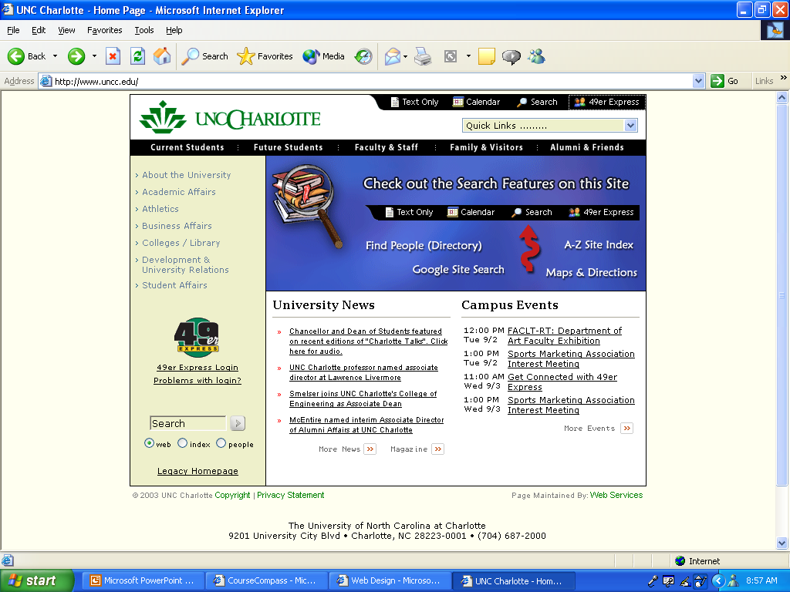

Slide 28
Navigation Through the Site
Don’t have to provide every navigation aid to every user on every page
Arrange aids so they:
Obvious
Consistent
Easy to use
Take up as little “floor space” as possible

Slide 29
Feedback and Interaction
Internet is two-way
State interactivity goals in site’s purpose
Is collecting user information important?
Explicit (user is aware)
Must allocate space on page(s)
Provide functionality (error checking, other)
Implicit (user is not aware)

Slide 30
Feedback and Interaction
Methods of interactivity
Forms (what information will be collected?)
Discussion boards
Asynchronous
Chat rooms
Synchronous
At early design stages just decide which forms are appropriate and support the site’s purpose(s).

Slide 31
Organizational Identity
Visual identity
Symbol
Nike swoosh
GE symbol
Ford oval
Color (IBM blue)
Sound
http://www.nascar.com/

Slide 32
Organizational Identity
Colors
Logo
Font
Design features
Shapes
Ford’s oval motif
Patterns
Mascots
Look and feel

Slide 33
Assignment
Hands-On Exercise
Your choice! Either #2 or #5
See Assignments Web Page for details

