Slide 1
JSON
JavaScript Object Notation

Slide 2
Uses
Ability to help humans read/write code easier
Consists of name / value pairs
Specified by Douglas Crockford RFC 4627
Application/json (unlike text/javascript)
Data over networks, like XML

Slide 3
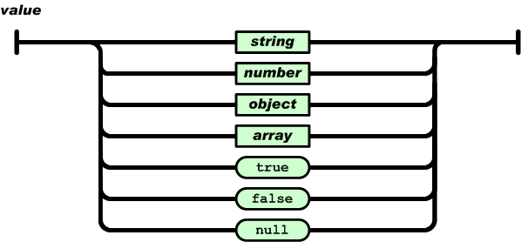
JSON Exmples

Slide 4
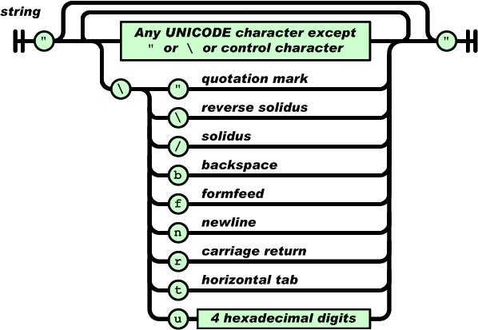
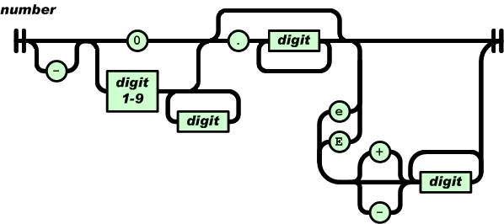
JSON Exmples

Slide 5
Need a Parser just as in XML
ASP
ActionScript
C
C++
C#
Fantom
Go
PHP
Pike
PL/SQL
PowerShell
Prolog
Python
Qt
Haskell
haXe
Java
JavaScript
Lasso
Lisp
LotusScript
Lua
Objective C
Objective CAML
OpenLaszlo
Perl

Slide 6
Need a Parser just as in XML
R
Racket
Realbasic
Rebol
RPG
Ruby
Scheme
Squeak
Symbian
Tcl
VB
Visual FoxPro

Slide 7
Examples

Slide 9
JSON vs XML List

