Slide 18
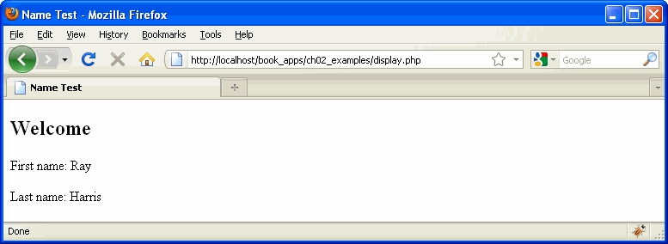

Slide 19
ajk note…
$_POST or $_GET ?
What if request form may be from different Web pages
What if the different pages use GET and POST
$_REQUEST
Contains data from
$_GET
$_POST
$_COOKIE

Slide 37
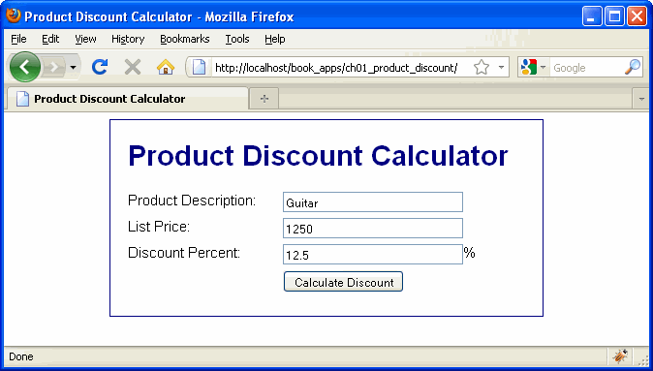

Slide 38
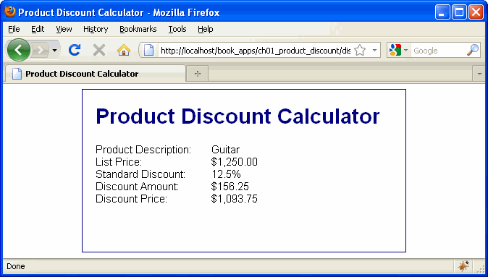

Slide 51
????????????????????????????????????????? -ajk
????????????????????????????????????????? -ajk

Slide 52
ajk note: there is a die function also, works just like exit. I like to use exit for normal end of program and die for abnormal ends

Slide 54
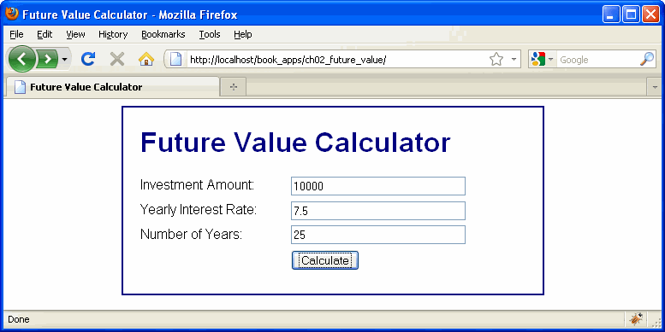

Slide 55
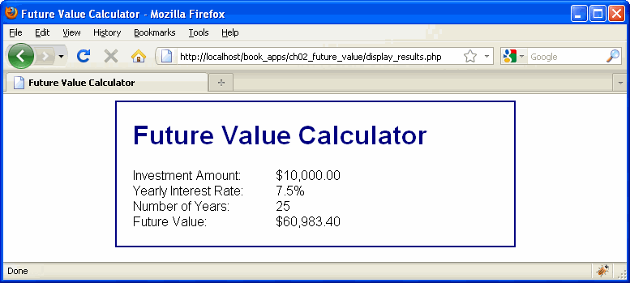

Slide 56
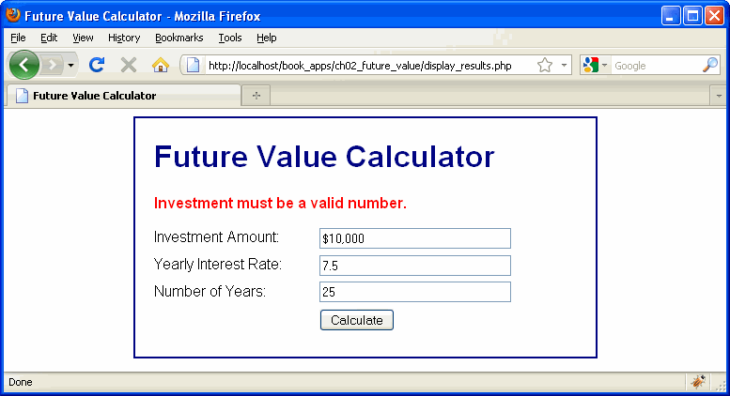

Slide 65
