Slide 4
Warning!
PHP does automatic type conversions
Depends on type and context
Called type coercion
Sometimes this is a real aid while coding
Sometimes this is a real PITA
Different versions of PHP may have different rules
Know the rules!
May be best to force your own conversions

Slide 8
See next page for ascii chart…

Slide 9
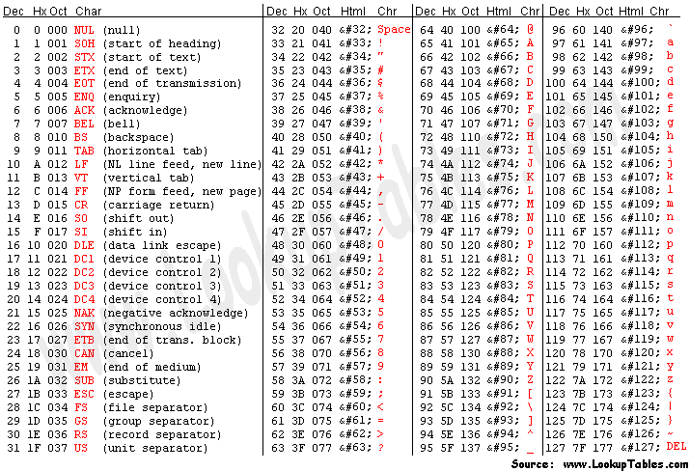

Slide 22
ajknote: the conditional operator is PHP’s only ternary operation

Slide 27
AJK Note: the above modfied code shows how the break can be more effectively used. The "A" gets an extra string the "B" does not.
AJK Note: there is a small potential problem in the above code. Anybody see it?

Slide 32
ajkExample: /ajk_apps/ch08/average.php

Slide 33
ajkExample: /ajk_apps/ch08/six.php

Slide 34
ajkExample: Ch08/maxsix.php

Slide 38
AJK Note: what is the inefficiency in the factors program?

