Slide 8
ajk Aside
Pass by value or Pass by reference?
Discuss:
Why Pass by Value
When to use
When to avoid
Why Pass by Reference
When to use (Why?)
When to avoid

Slide 10
ajkExample: /Ch13/referenceOrValue.php

Slide 13
ajkExample: /Ch13/globalVar.php

Slide 20
ajkExample: /Ch13/averageVar.php

Slide 30
ajkExamples: /Ch13/varFunc.php

Slide 31
ajkExamples: /Ch13/callback.php

Slide 34
Anonymous Functions

Slide 35
usort: sorts an array by a user defined comparison function
$function must return for elements in array
-1 : a<b
0 : a=b
1 : a>b

Slide 37
<?php
$card_order = array('ace' => 14, 'king'=>13,'queen'=>12,'jack'=>11,'ten'=>10,'nine'=>9);
echo "<br>Card order:" . var_dump($card_order) . "<br>";
function print_deck($when, $the_cards) {
echo "$when [";
foreach ($the_cards as $card) { echo $card . " : “; }
echo "]<br>";
}
$card_sort_function = function($card1, $card2) {
global $card_order;
if ($card_order[$card1] < $card_order[$card2]) $rval = 1;
if ($card_order[$card1] == $card_order[$card2]) $rval = 0;
if ($card_order[$card1] > $card_order[$card2]) $rval = -1;
return $rval;
};
// Test function
echo "Testing sort:[" . $card_sort_function('ace', 'ten') . "] <br>";
// Create the hand to sort
$cards = array('ten', 'ace', 'queen', 'king', 'nine', 'ten', 'nine', 'ace', 'ten', 'ace');
print_deck("Before", $cards);
usort($cards, $card_sort_function);
print_deck("After", $cards);
?>
ajkExamples: /Ch13/customSort.php

Slide 38
Closures

Slide 40
ajkExamples: /Ch13/closure.php

Slide 42
Review cart code yourself!

Slide 43
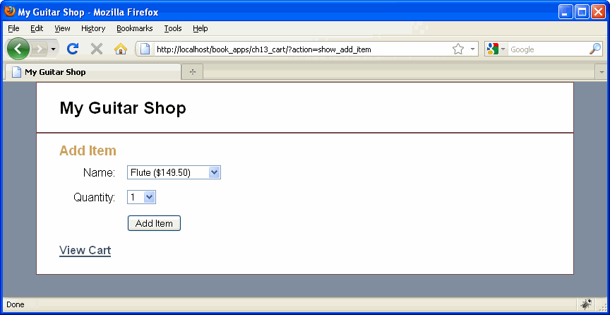

Slide 44
