Slide 15
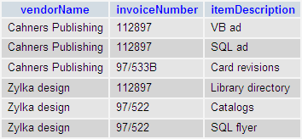
Discuss: what is wrong with the first table?

Slide 18
http://www.bkent.net/Doc/simple5.htm

Slide 29
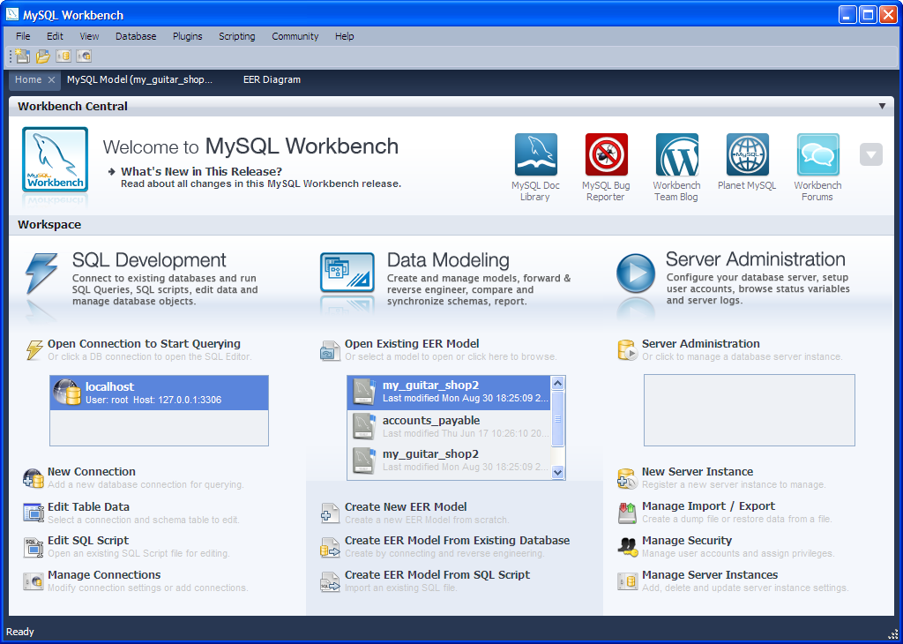

Slide 30
