Slide 4
Note: Drop deletes a database and destroys all the data in it. No recovery!

Slide 5
http://dev.mysql.com/doc/refman/5.6/en/numeric-types.html#integer-types
Note: there are differences in the data types between different systems. e.g. MySQL has tinyint (an extention), DB2 only has smallint.

Slide 9
Note: in the above examples the column-level and table-level PKs work the same. However with the table-level method a PK can be defined with multiple columns.

Slide 13
AJK Note: In general, any developer should NEVER touch a production database (or code for that matter). The developer should thoroughly test the application, then pass it on to the production system administrators. They should then thoroughly test the application before installing it. The same is true for any changes to the database structure and tuning.

Slide 24
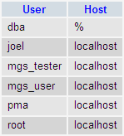

Slide 27
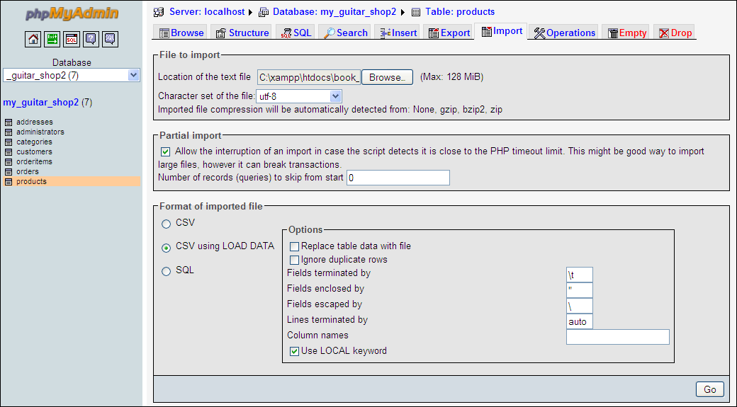

Slide 30
